Slide 2
DEDICATED TO THE RESEARCH, DEVELOPMENT AND MANUFACTURING OF
MULTIPROCESS PRINTING AND FINISHING SYSTEMS

Slide 3
35
YEARS
OF INNOVATION
Since 1988

Slide 4


A GLOBAL WORLDWIDE NETWORK.
North America
South America
Europe
Africa
Middle East
India
Asia
Oceania

Slide 5
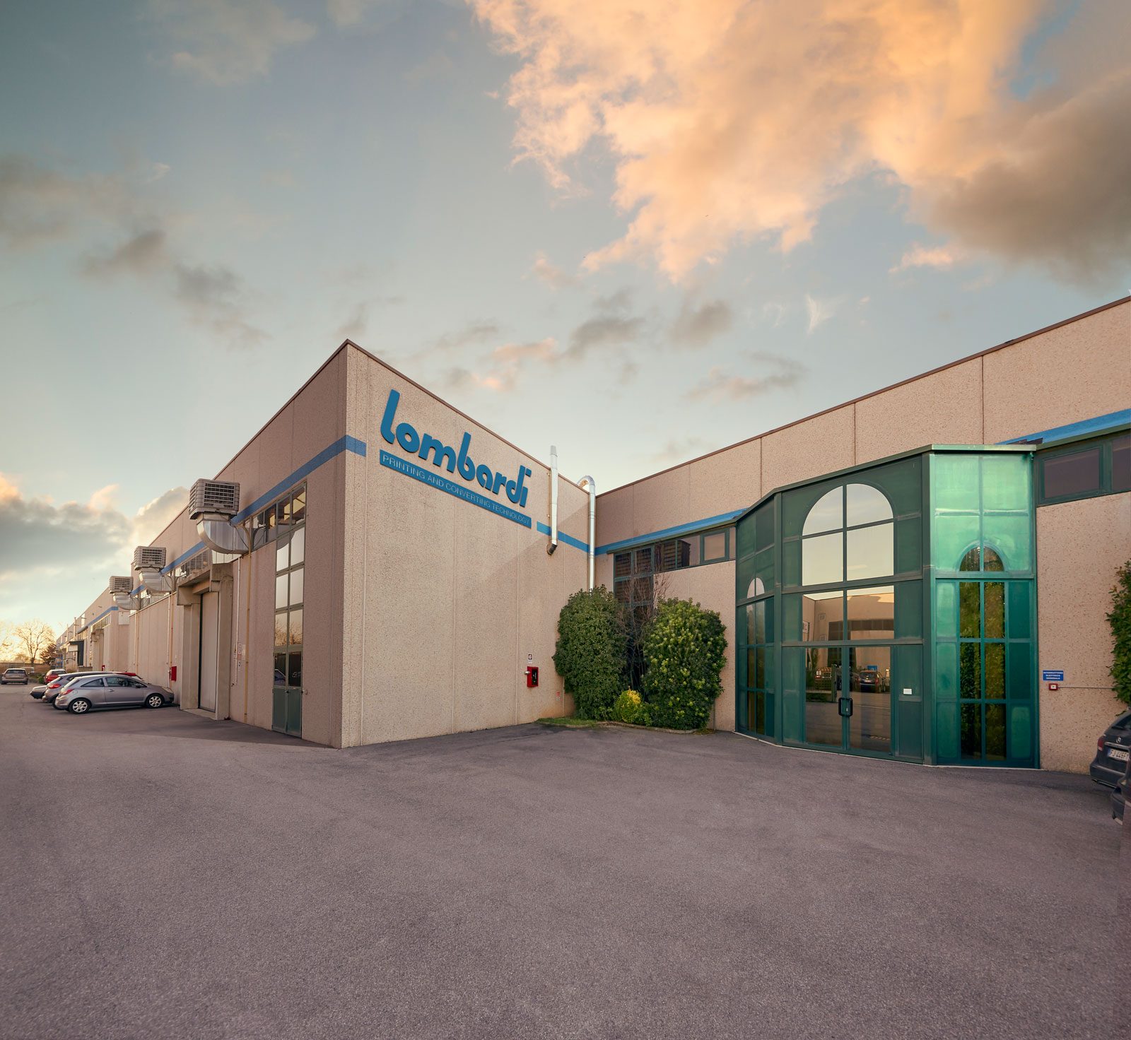
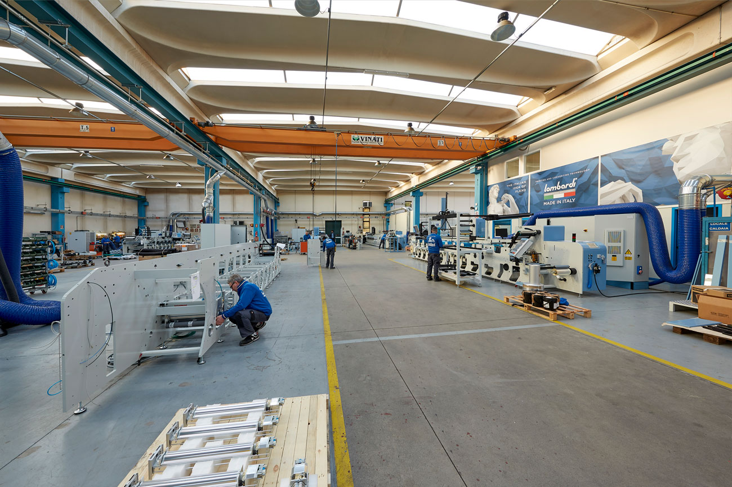
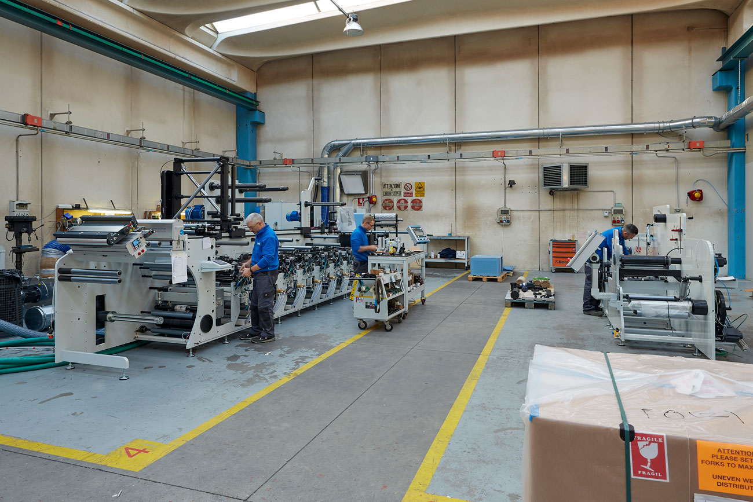
MADE IN ITALY SINCE 1988
MADE IN ITALY SINCE 1988
LombardiHead
Quarters
Italian quality
Since 1988
Lombardi Converting Machinery was founded 35 years ago in Brescia Italy. We specialize in the production of printing & converting machinery for the narrow and mid-web label and flexible packaging industry. Known world wide for Quality and Technology, we are involved in the design and manufacturing of modular, highly automated flexographic printing machines tailored to our customers specific requirements.
5

Slide 6

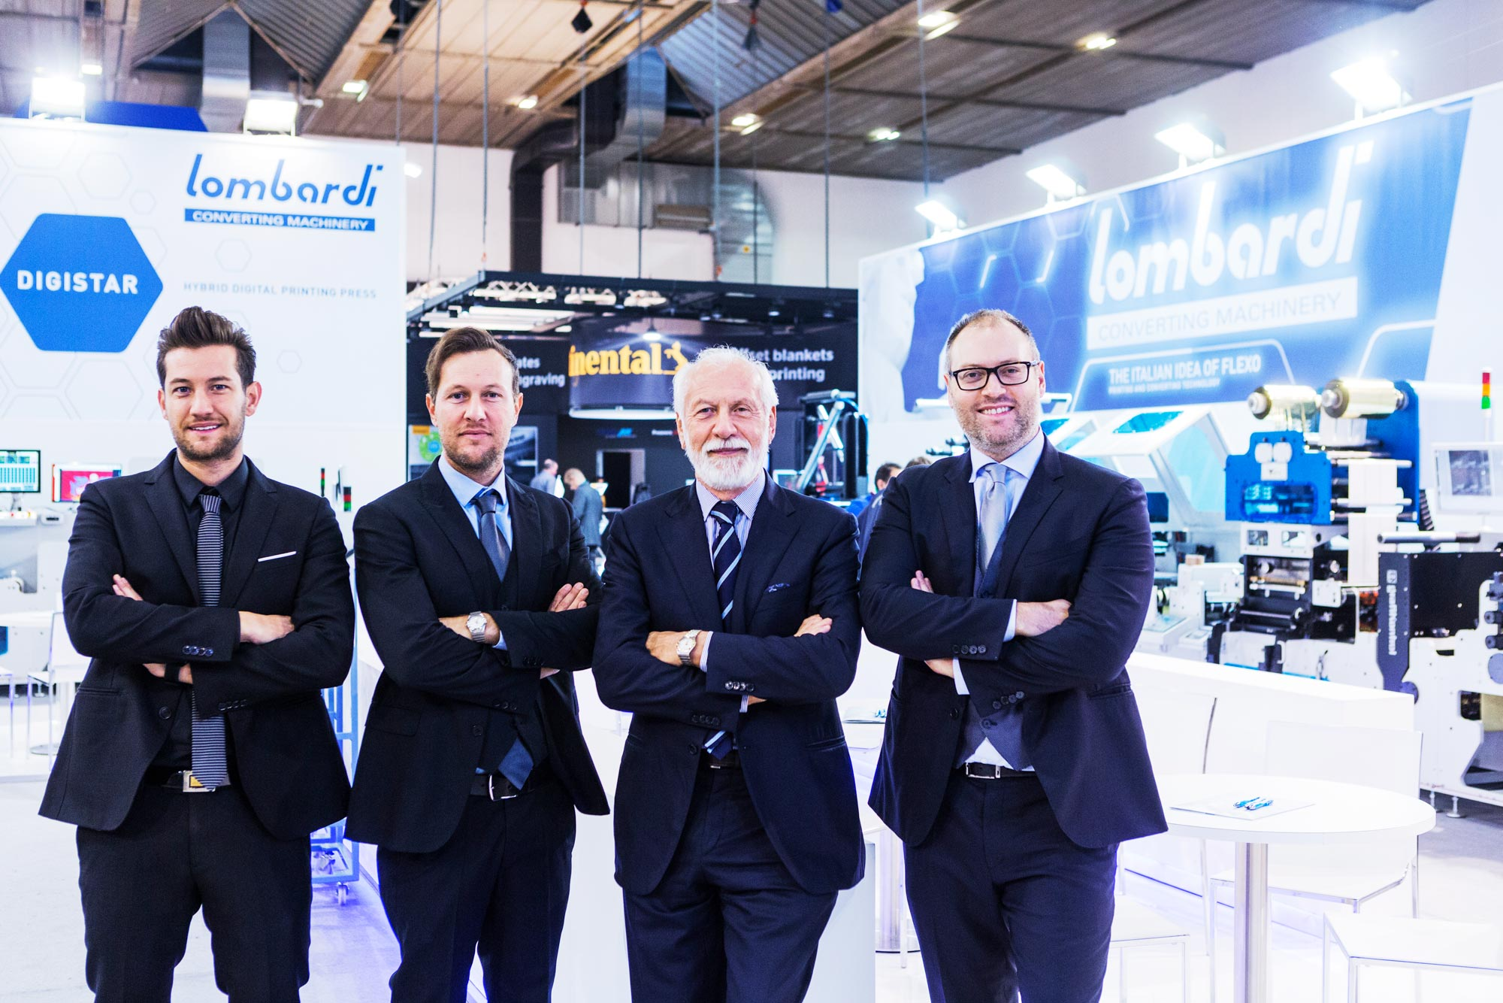
MADE IN ITALY SINCE 1988
FAMILY CULTURE ENTERPRISE
Nicola
Lombardi
Marketing
Manager
Lorenzo
Lombardi
General
Director
Claudio
Lombardi
Company
Founder
Massimo
Lombardi
General
Director
6

Slide 7
ITALIAN
QUALITY
Our mission, since the inception of the company, has been to reach Customer Satisfaction by offering the best quality and tailor made solutions. The “Italian Idea of Flexo” was presented in 2015 as our signature. With over 1500 installations world wide, Lombardi is renowned for quality and highly advanced technological solutions for all our customers printing needs.

Slide 8
OUR
GOALS
Developing State of the Art Flexographic Printing and Finishing Machines is our mission. High performance, user friendliness, low waste, and high run time rates for all of our equipment are our requirements. We achieve customer satisfaction by engineering technologically advanced equipment that embodies the true soul of “Made in Italy”. We enable our customers to run efficiently and effectively with comprehensive support operations and real time remote control technologies.

Slide 9
CORPORATE
VISION
& MISSION
Constant investments in Research & Development have allowed us to grow. Our family structure allows decisions to be made in a timely and flexible manner while always remaining faithful to the values and guidelines that have made our company successful for the last 35 years. Innovation, Customer Satisfaction, and our “Made in Italy” quality are the fundamental principles that underline our corporate vision.

Slide 10

MADE IN ITALY SINCE 1988
FLEXIBILITY
4
TECHNOLOGY
CARDINAL
POINTS
MODULARITY
SMARTNESS

Slide 11

MADE IN ITALY SINCE 1988
TECHNOLOGY
SOFTWARE
PRE-REGISTER ACCURACY
REGISTER ACCURACY
REGISTER SPEED
2° PASS
CROSSED PHOTOCELLS READING
PRINT REPEAT CHANGE
INTEGRATION OF DIFFERENT PROCESSES
TENSION CONTROL

Slide 12

MADE IN ITALY SINCE 1988
TECHNOLOGY
ENGINEERING
SMART MECHANICAL DESIGN
PERFORMANCE IMPROVEMENT
FAST JOB CHANGE OVER
OPERATOR ERGONOMIC AND USER FRIENDLINESS
COMPLIANCE WITH SAFETY STANDARDS
12

Slide 13

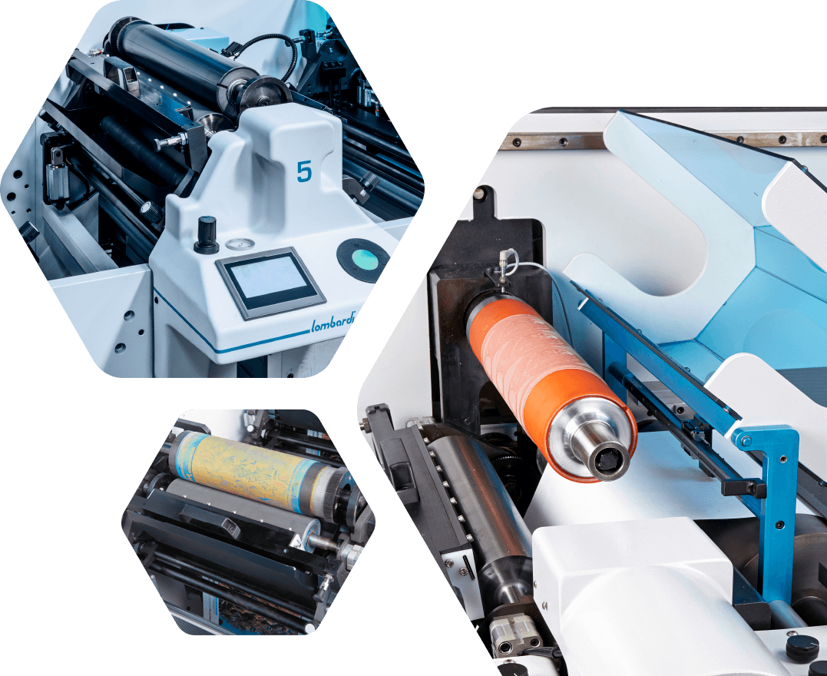
MADE IN ITALY SINCE 1988
SMARTNESS
TECHNICAL
SOLUTIONS
ABS SYSTEM
PNEUMATIC BLADE
PRESSURE INK PAN
EASY PRESSURE ADJUSTMENT
INDEPENDENT MOUNTING
FOR EACH COMPONENT

Slide 14
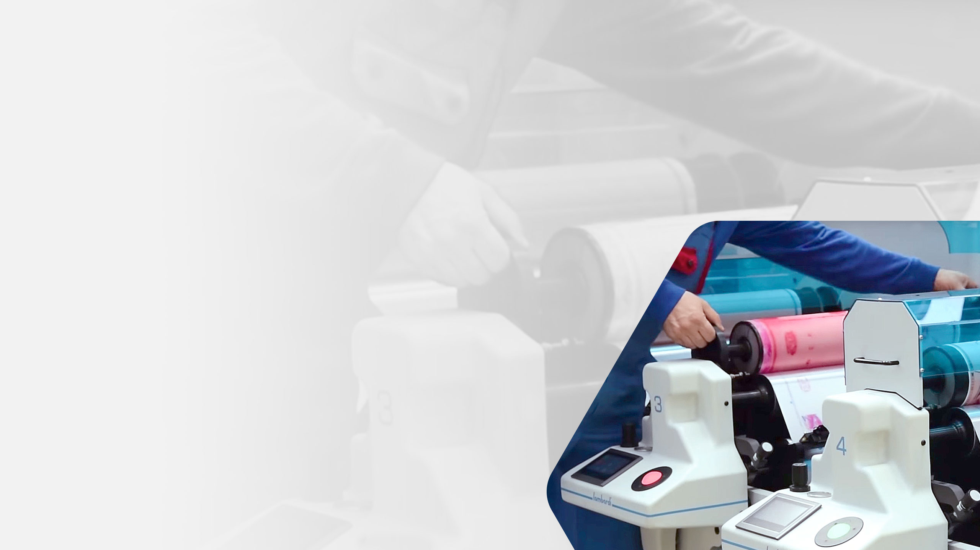
MADE IN ITALY SINCE 1988
SMARTNESS
OPERATOR
ADVANTAGE
BLADE PARALLELISM
AUTO-ADAPTIVE SYSTEM
LONGER ANYLOX LIFE
HOMOGENEITY IN INK DISTRIBUTION
EASY AND FAST JOB CHANGE OVER
EASY INK PAN CHANGE OVER
14

Slide 15

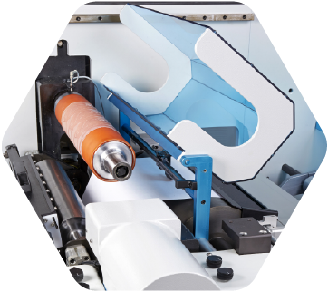
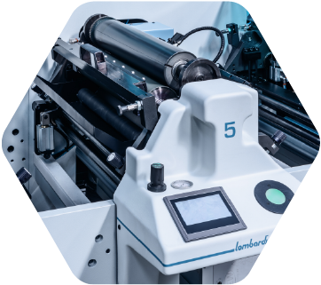
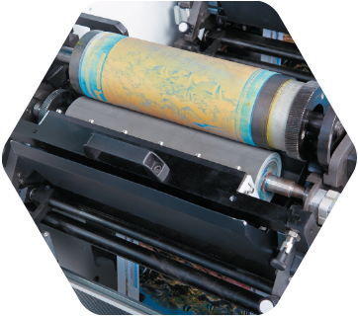
SMARTNESS
[ CONFIGURATION ]
ABS
ABS SLEEVE
ABS SERVO
ABS BASIC

Slide 16
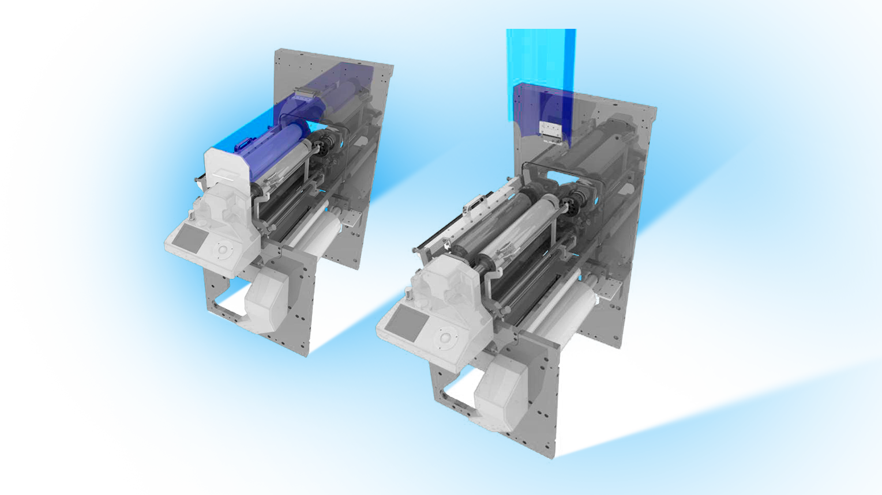
MADE IN ITALY SINCE 1988
SMARTNESS
[ CONFIGURATION ]
ABS
SERVO

Slide 17
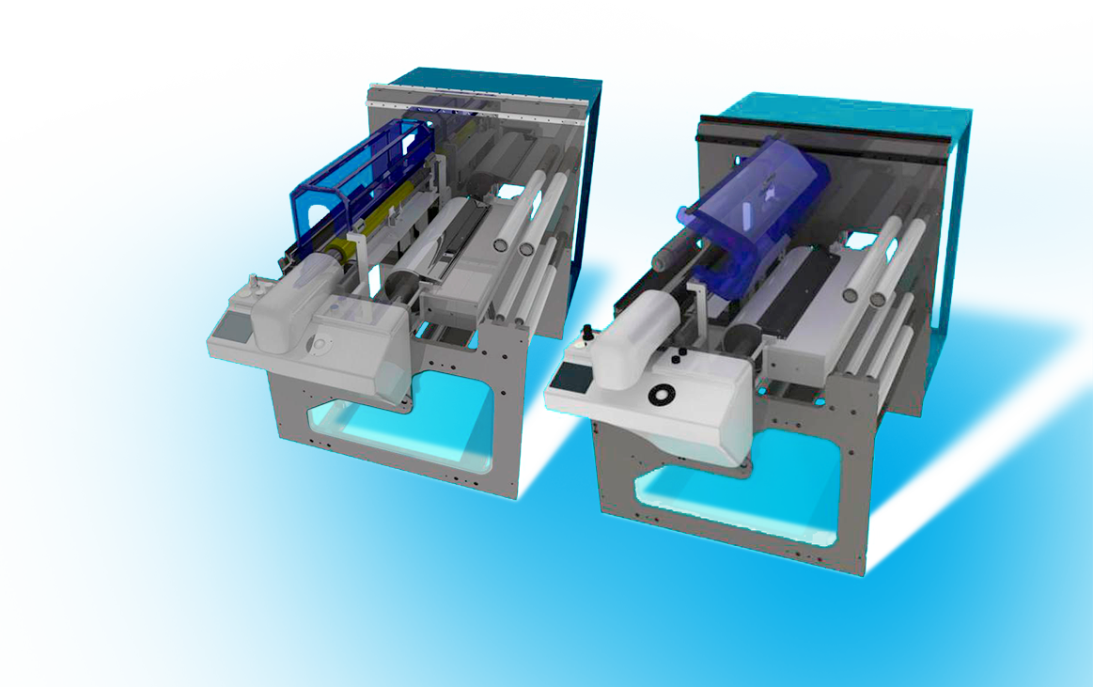
MADE IN ITALY SINCE 1988
SMARTNESS
[ CONFIGURATION ]
ABS
SLEEVE

Slide 18

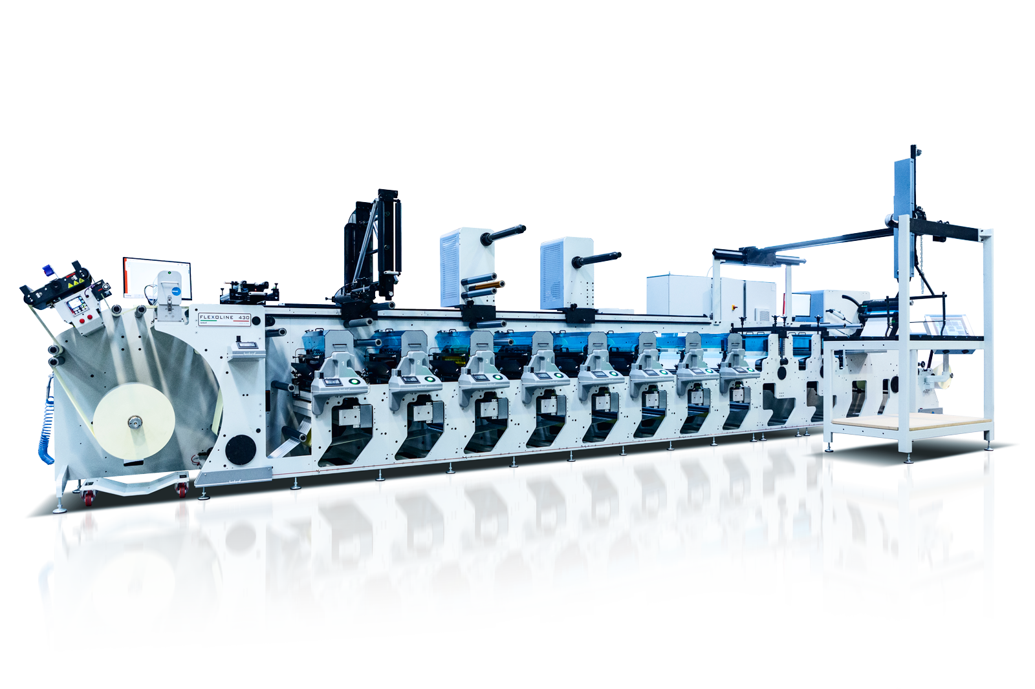
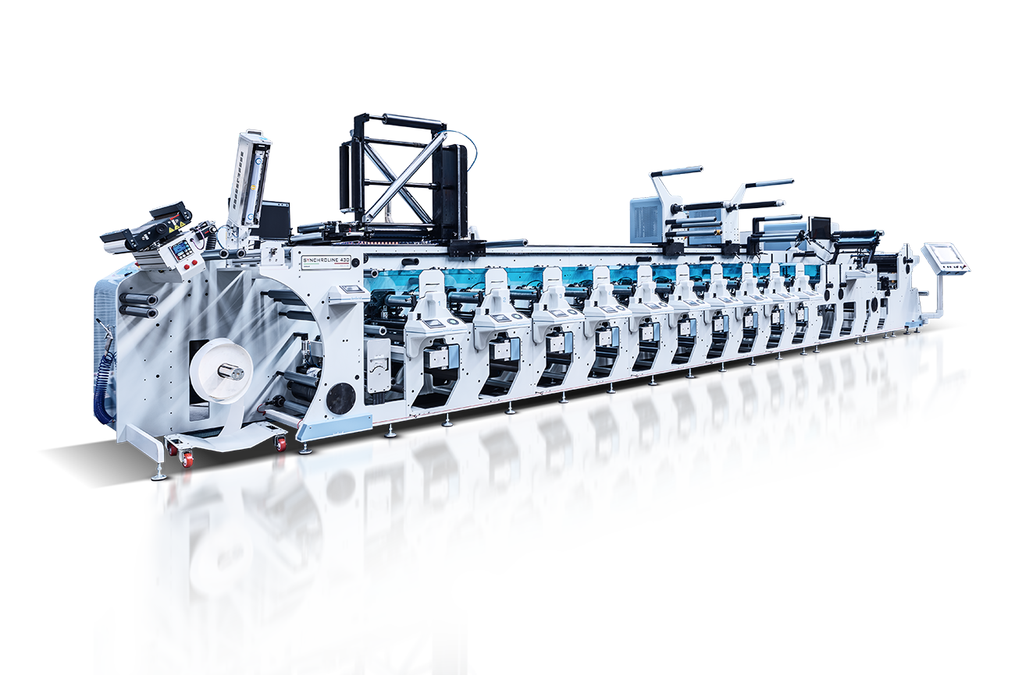
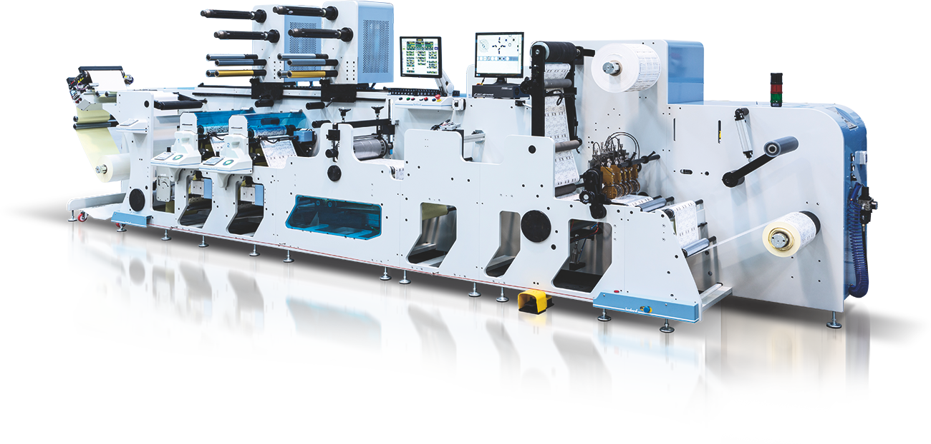
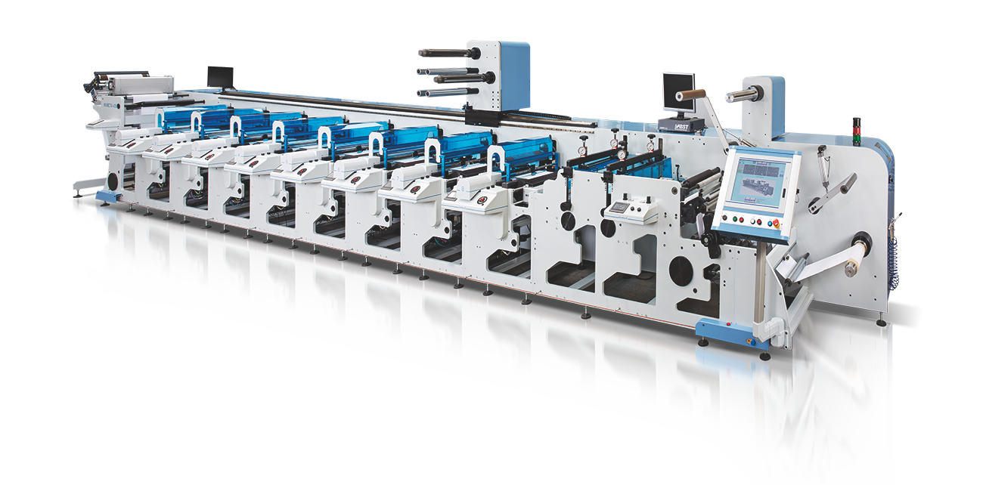
MADE IN ITALY SINCE 1988
FLEXIBILITY
FLEXIBILITY
RANGE
WIDTH 300 > 1000
FLEXO | SYNCHRO | INVICTA | DIGISTAR | UNITS
NUMBER OF COLOR UNITS
MODULES PLACEMENTS
18
18

Slide 19

MADE IN ITALY SINCE 1988
FLEXIBILITY
[ FLEXIBILITY ]
FLEXIBILITY
INTEGRATION WITH EXTERNAL MECHANICAL SYSTEM
INPUT, OUTPUT
INTEGRATION WITH EXTERNAL SOFTWARE SYSTEM
MANAGEMENT SYSTEM
PREDISPOSITION TO CUSTOMIZATION
TECHNICAL DEP / SERVICE DEP
19
19

Slide 20
MADE IN ITALY SINCE 1988
MODULARITY
WHY A MODULAR VISION?
HIGHER VALUE OF FINAL PRODUCT
(HOT STAMPING, SCREEN PRINTING)
PROCESSING SPEED
NEW PRINTING SOLUTIONS
PROCESS OPTIMIZATION
ECONOMICAL BENEFITS
20
20

Slide 21
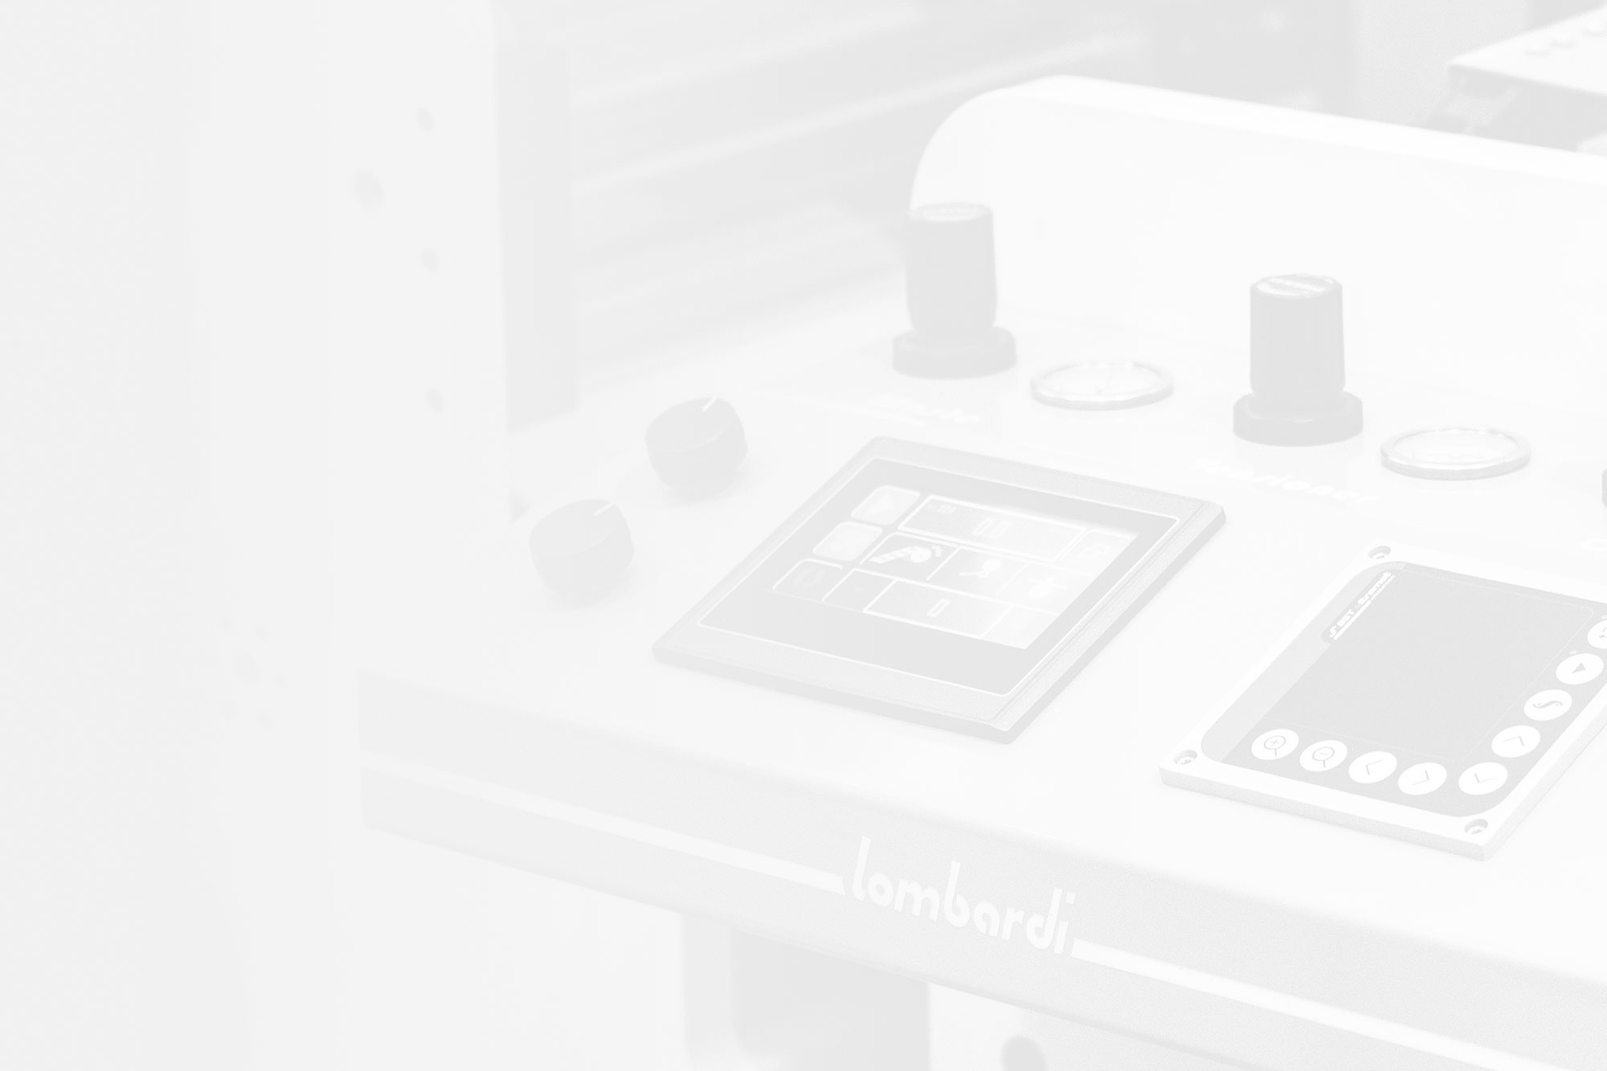
MADE IN ITALY SINCE 1988
MODULARITY
CHALLENGES
MECHANICAL INTEGRATION OF DIFFERENT PROCESSES
(HOT STAMPING, SCREEN PRINTING)
SOFTWARE INTEGRATION
21
21

Slide 22
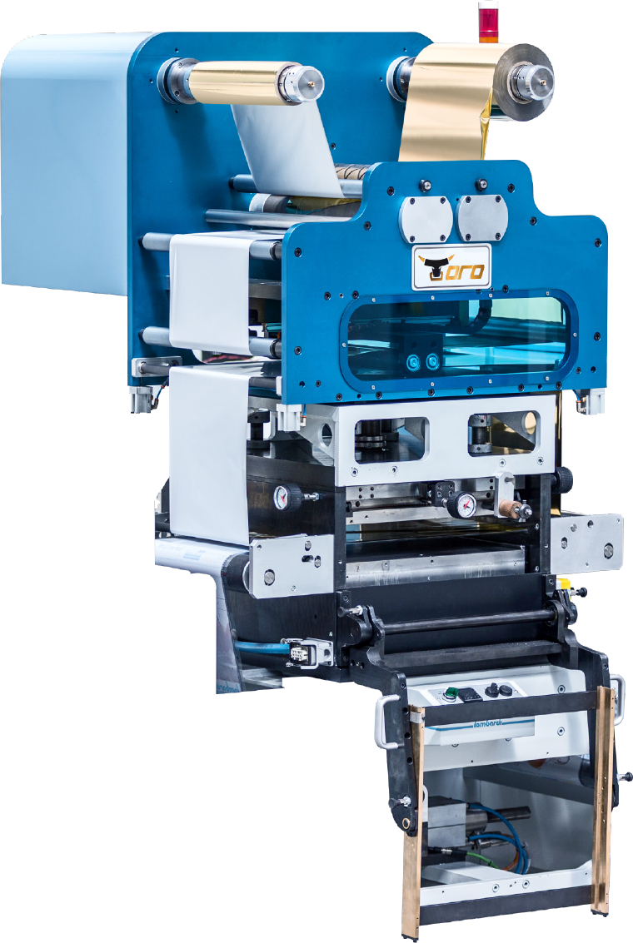
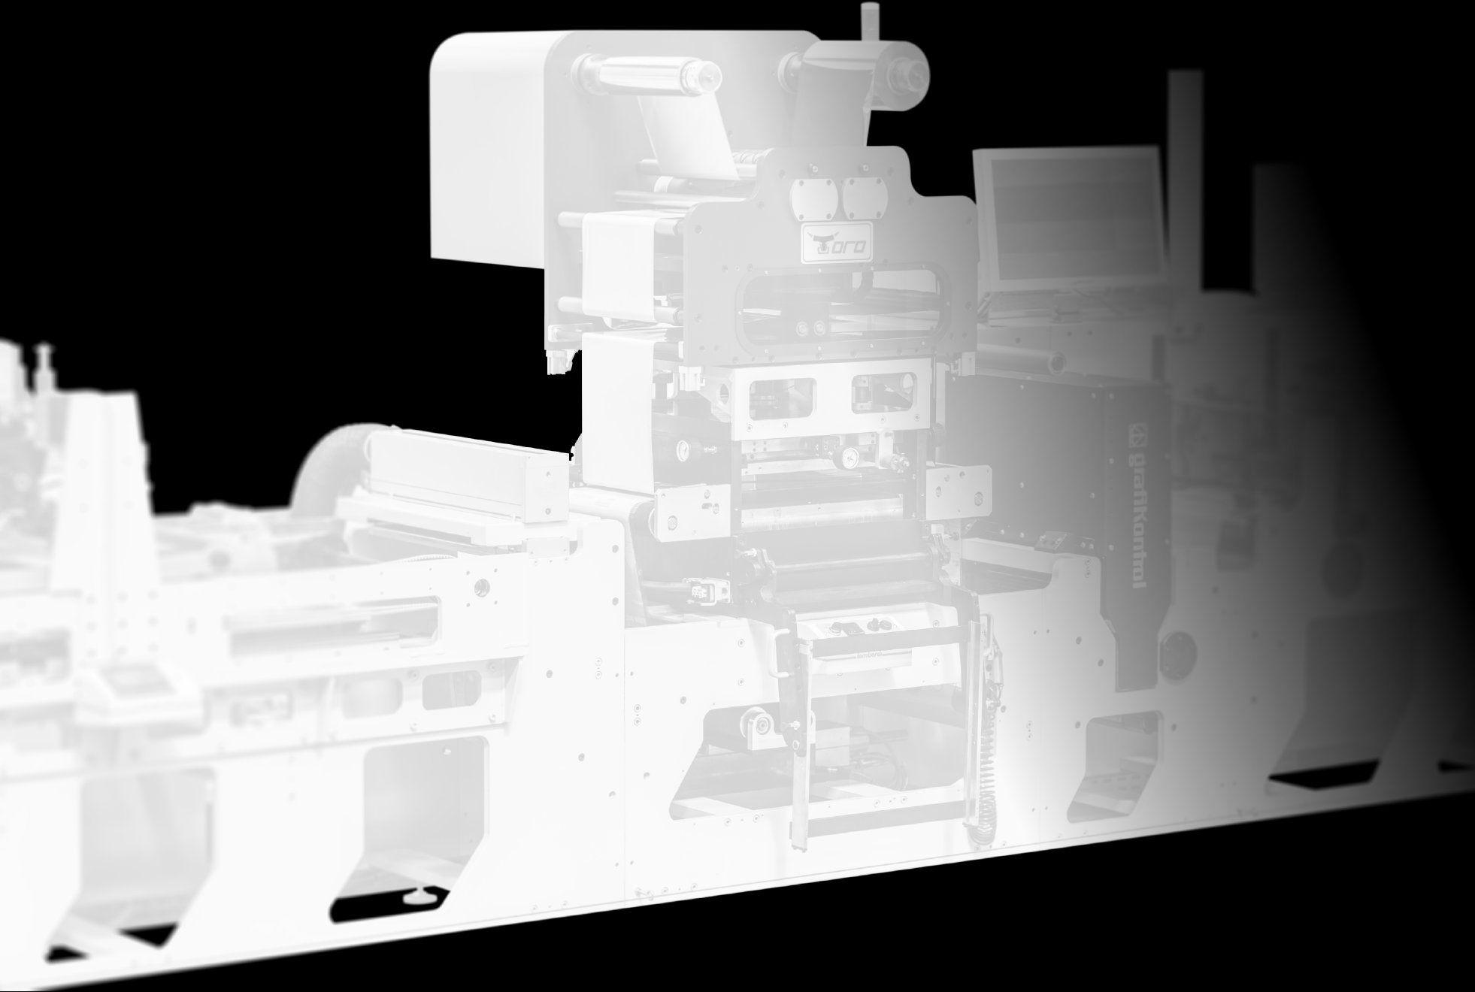

MODULAR SOLUTIONS
TORO
A most innovative in-line hot stamping unit capable of reaching high speeds. Equipped with foil saver and Hologram insetting, this unit is also the ideal solution for creasing and quality label embossing.
22
22
22

Slide 23
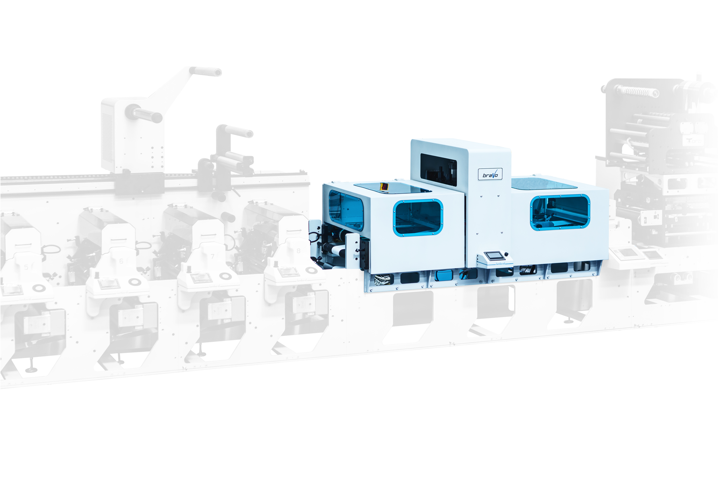

MODULAR SOLUTIONS
BRAVO
High performance, in-line flat screen unit. Designed as an alternative to off-line printing processes, it enables the production of quality labels in a single process.
23
23
23

Slide 24
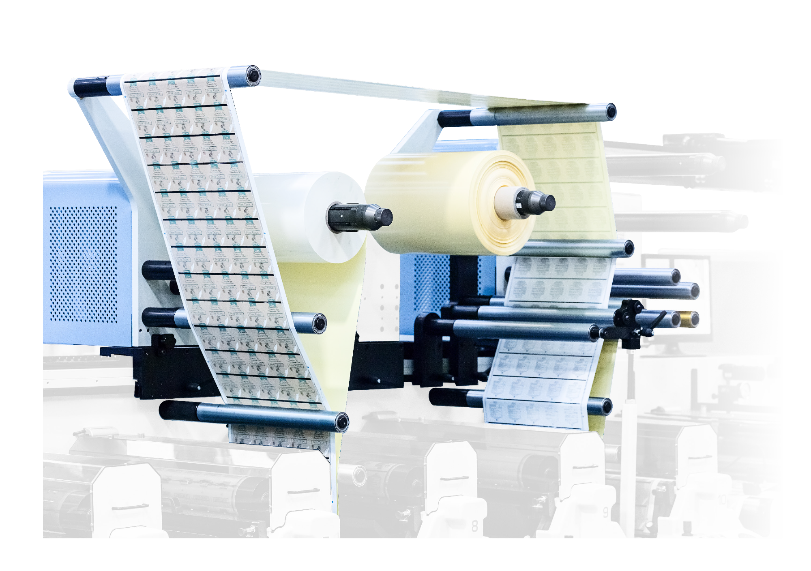
MODULAR SOLUTIONS
BOOKLET
Needed for the creation of
multi-page labels, the booklet unit guarantees
High production as well as Perfect register.
24
24
24

Slide 25
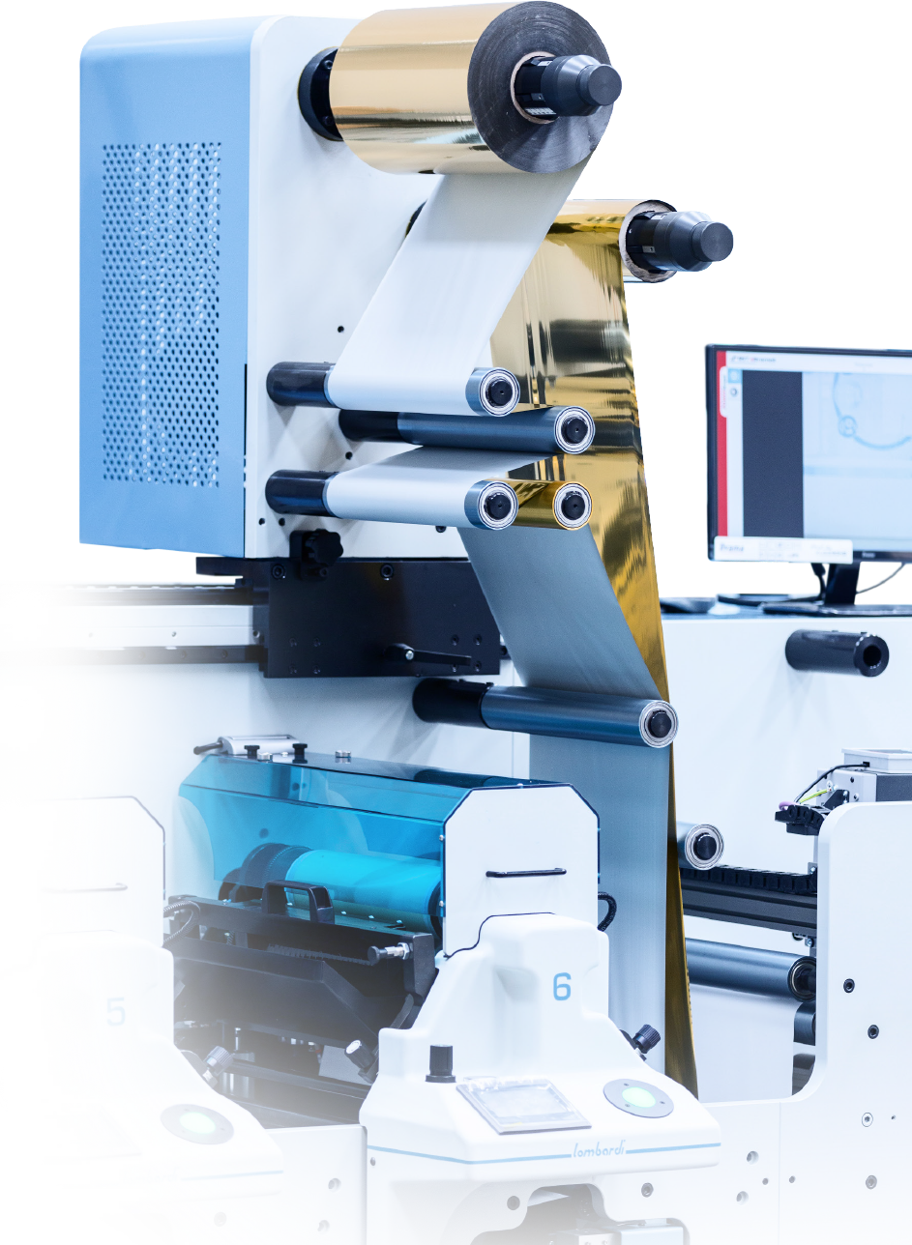
MODULAR SOLUTIONS
COLD FOIL
Cold foil is the right application
for high quality labels. You can position it by rail on any color
group.
25
25
25

Slide 26
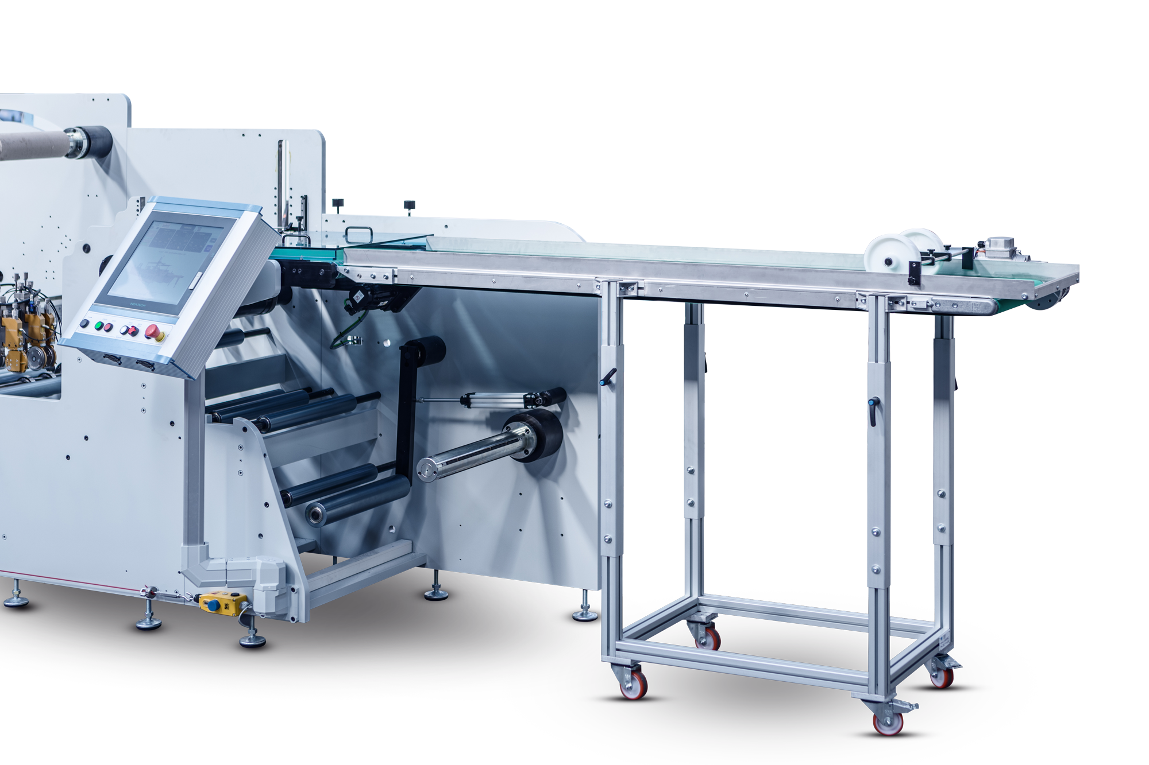
MODULAR SOLUTIONS
SHEETER
Sheet Output Unit
(A4) alternatively
with tape for output of shaped
labels.
26
26
26

Slide 27
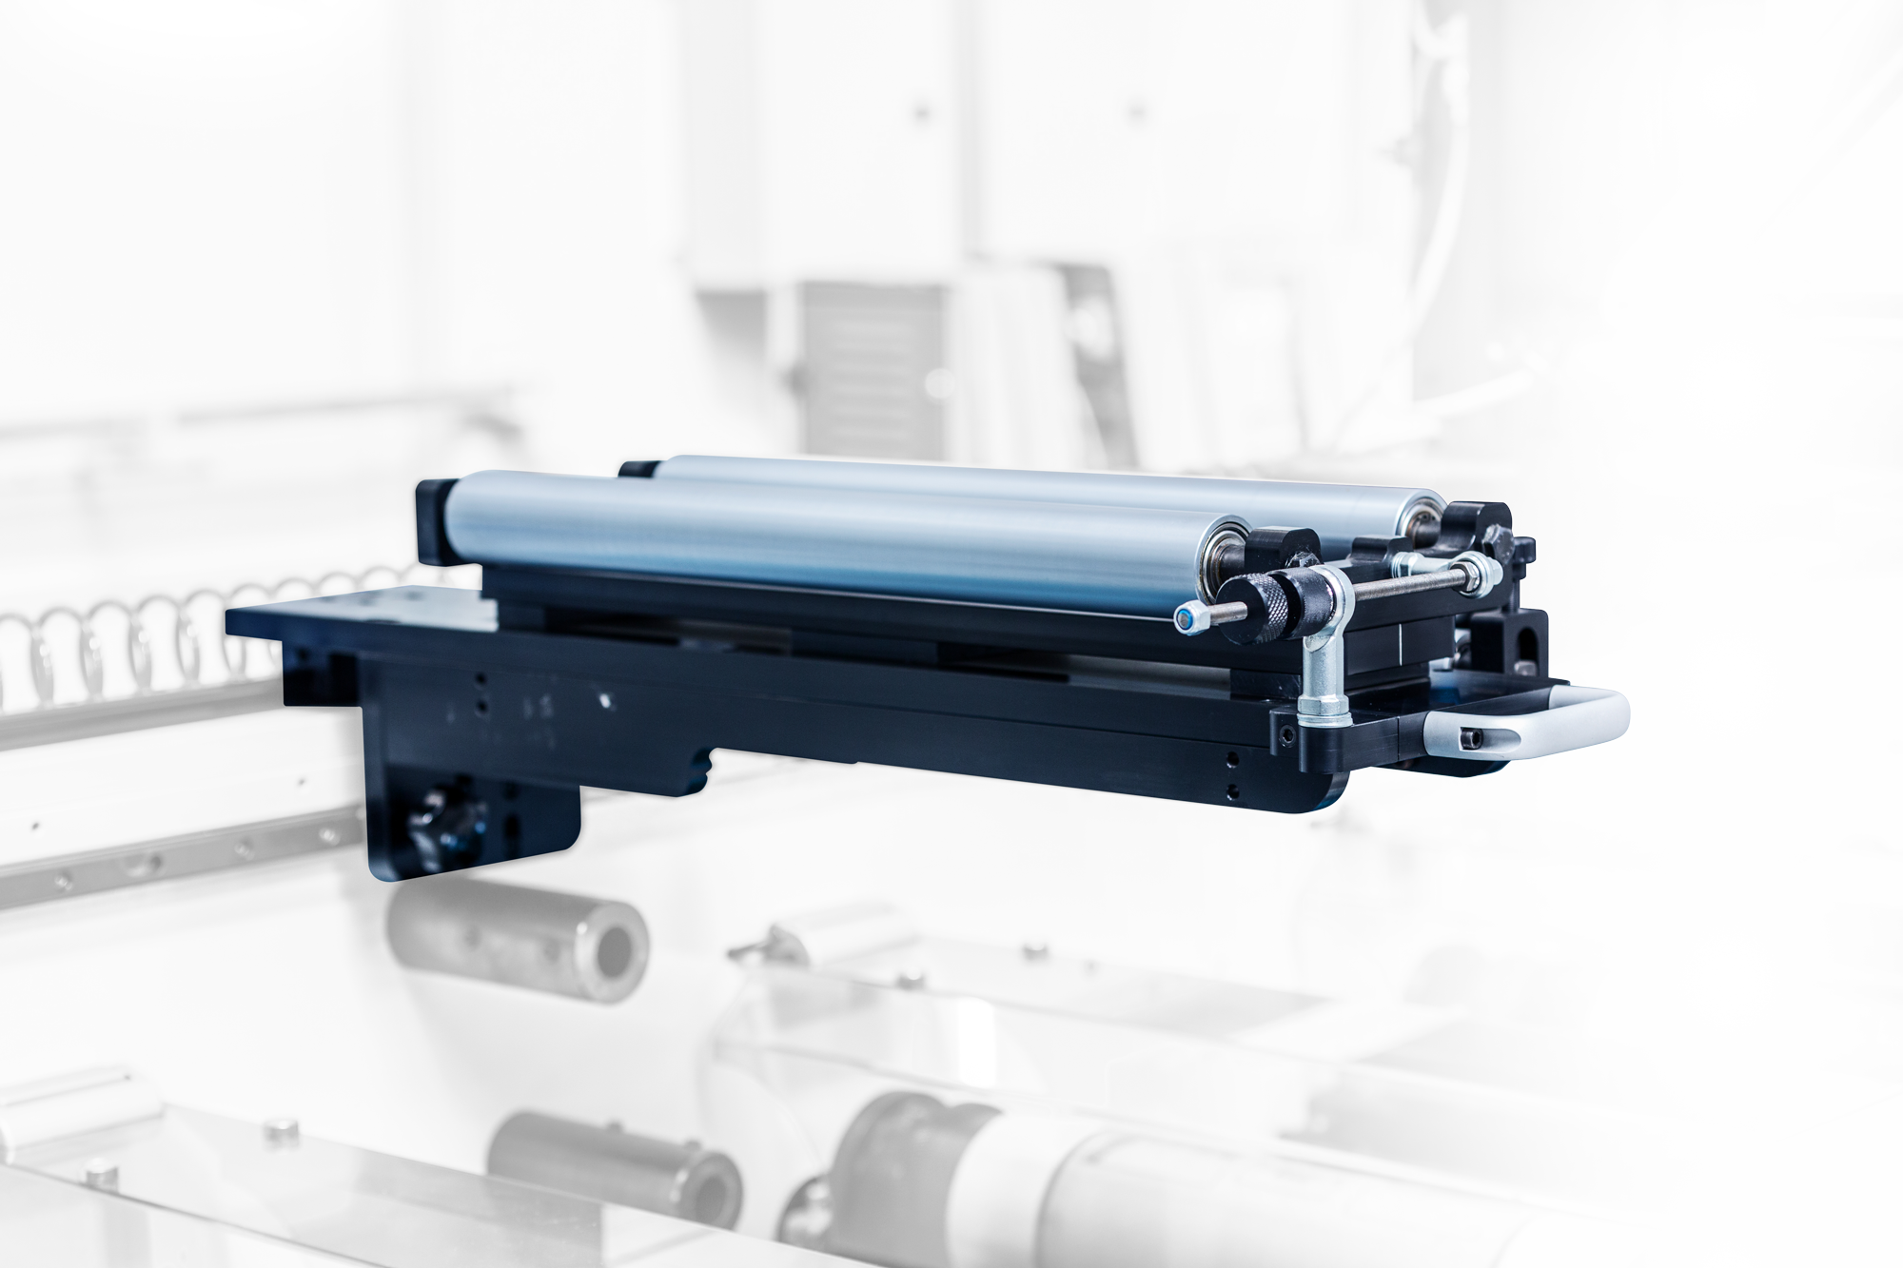
MODULAR SOLUTIONS
The DeLam ReLam unit enables the separation of adhesive paper allowing for printing on the glue side and then recoupling of the web The DeLam ReLam unit enables the separation of adhesive paper allowing for printing on the glue side and then recoupling of the web
DELAM
RELAM
Unit that allows
the separation of
adhesive paper allowing for printing on the
glue side and then
re-coupling.
27
27
27

Slide 28
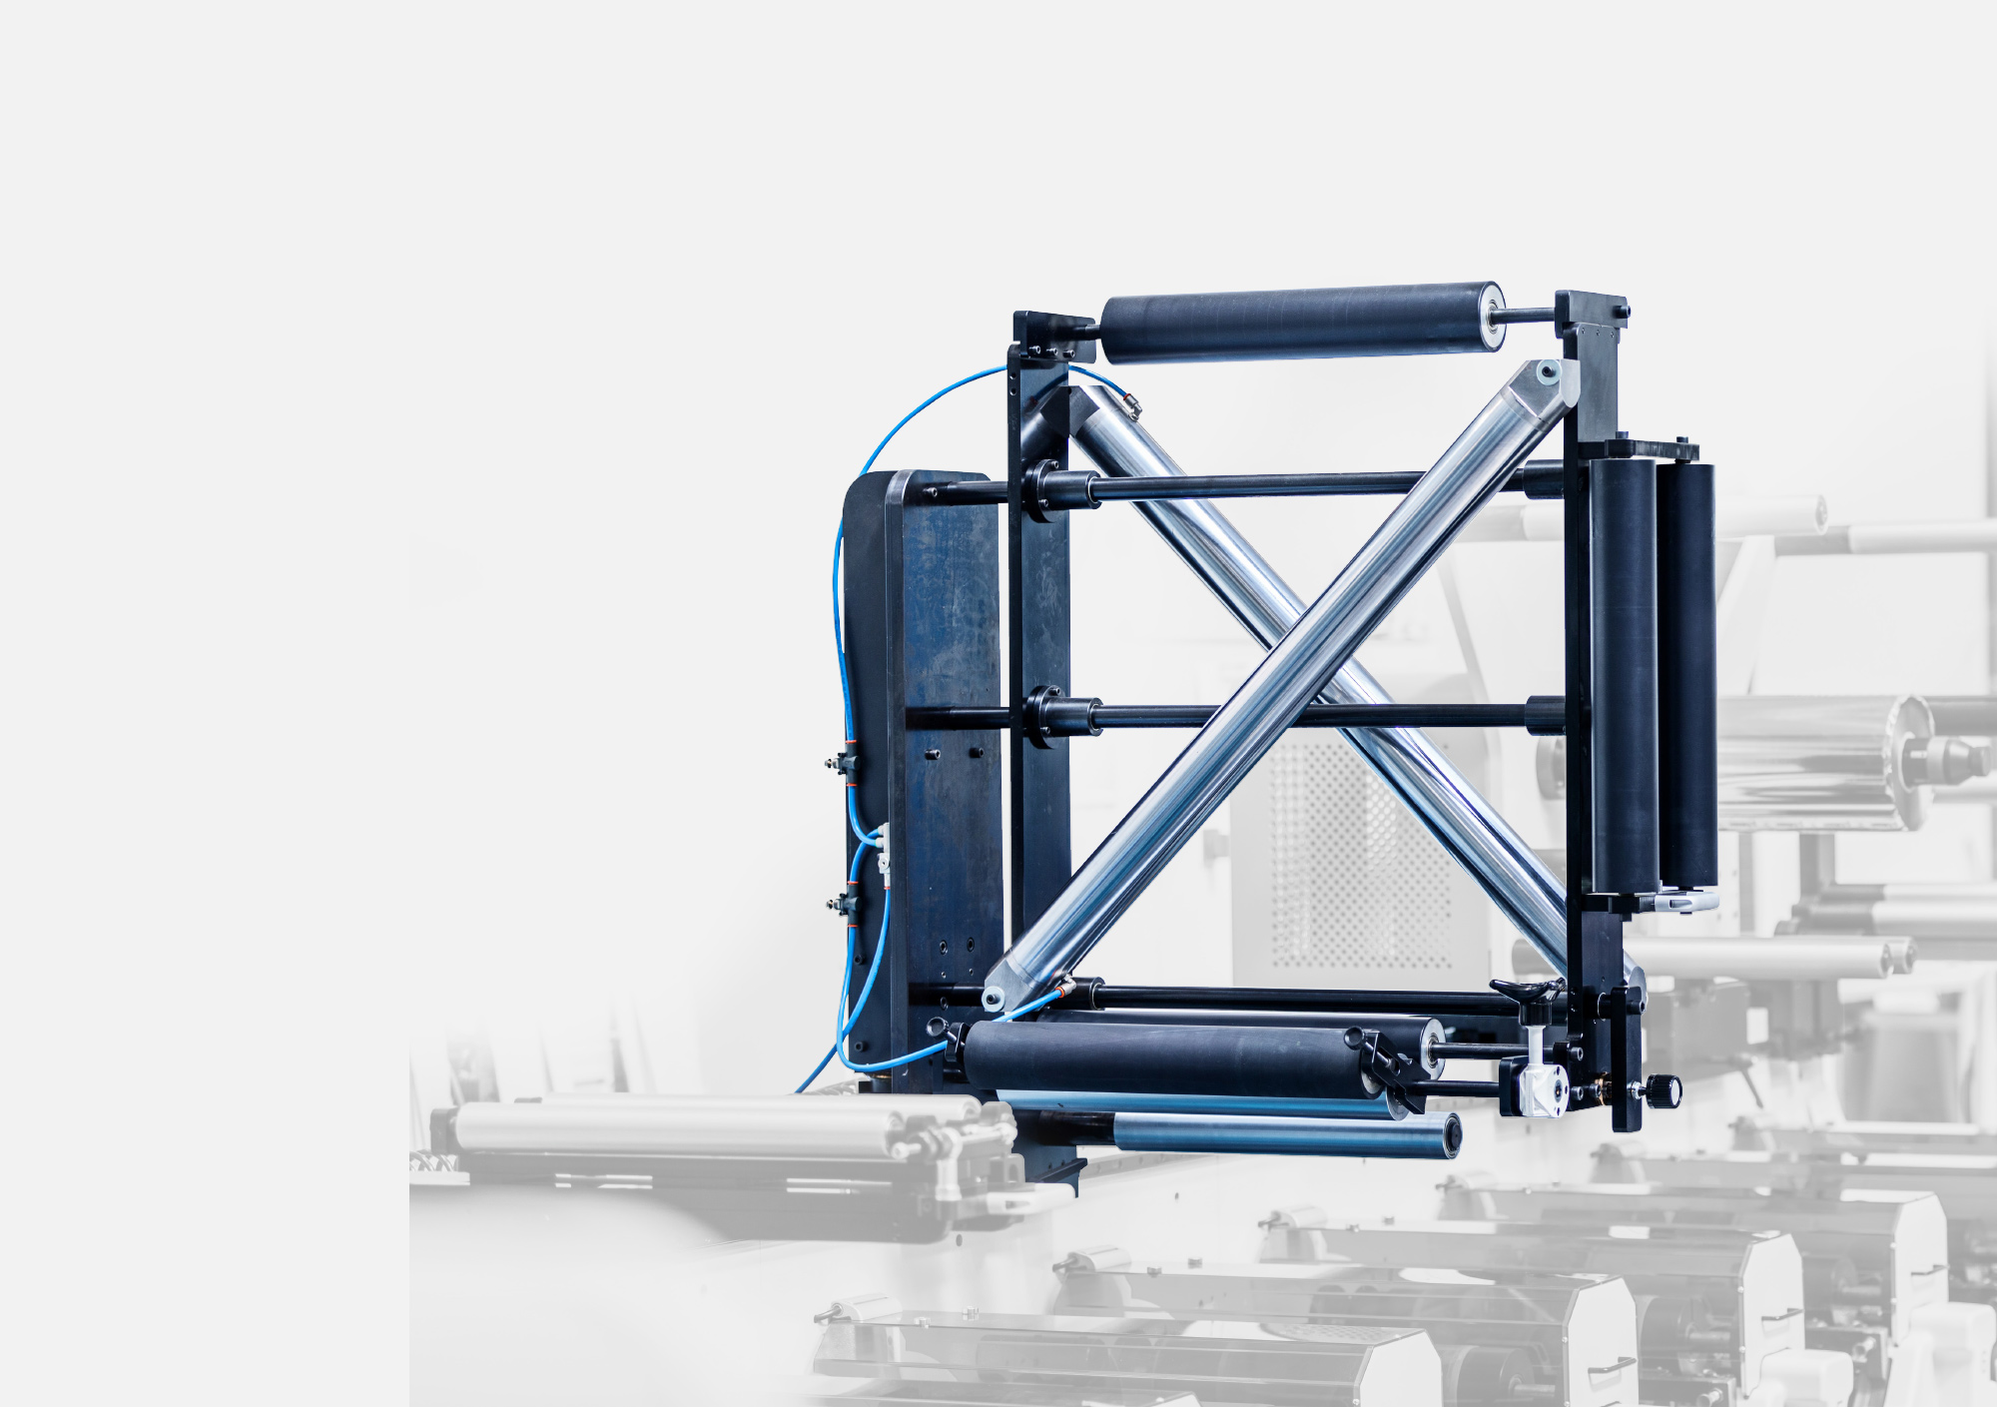
MODULAR SOLUTIONS
TURN BAR
Unit that allows printing on the back of web.
28
28
28

Slide 29
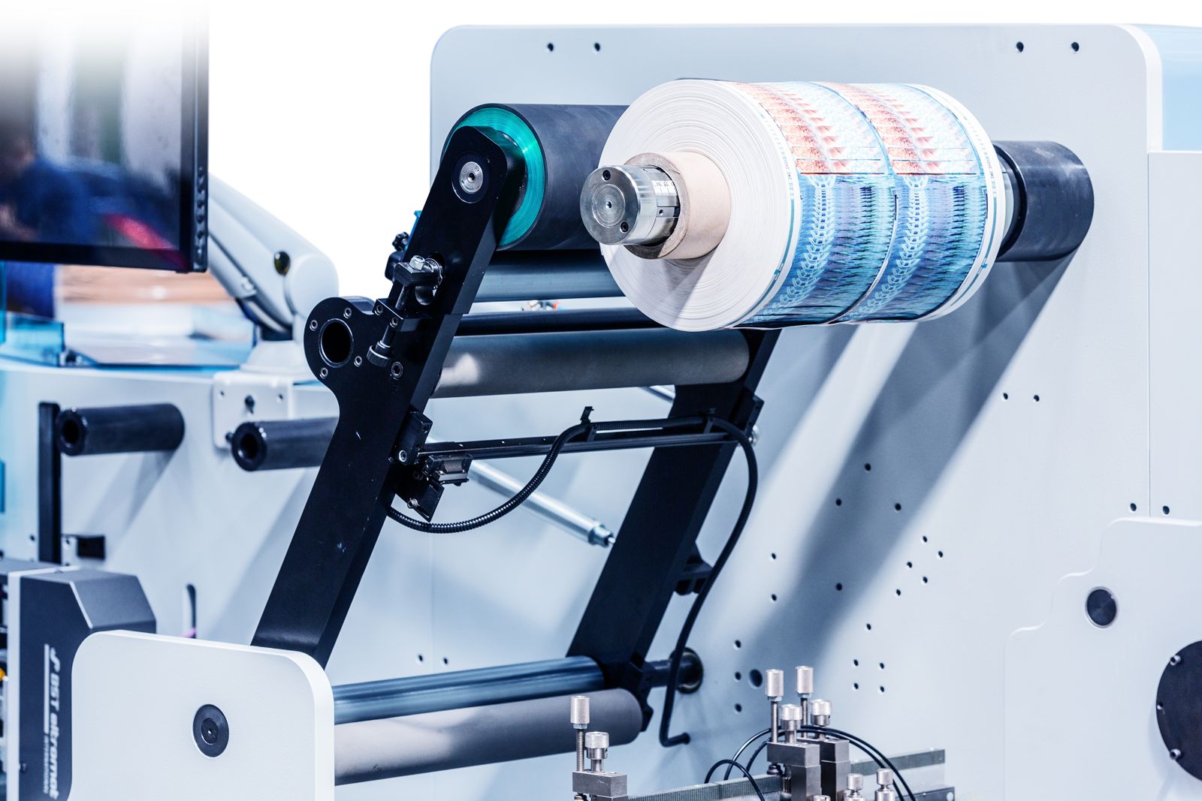
MODULAR SOLUTIONS
EASY
WASTE
Unit that allows you to remove
asimmetrical waste at high-speed.
29
29
29

Slide 30
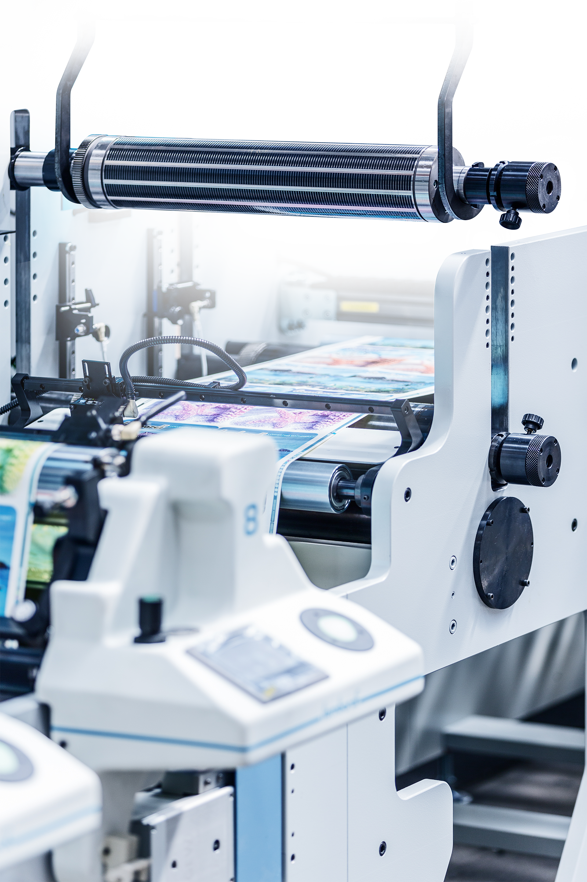
MODULAR SOLUTIONS
ROTARY
DIECUT
A unit that allows the die cutting of any label shape.
30
30
30

Slide 31
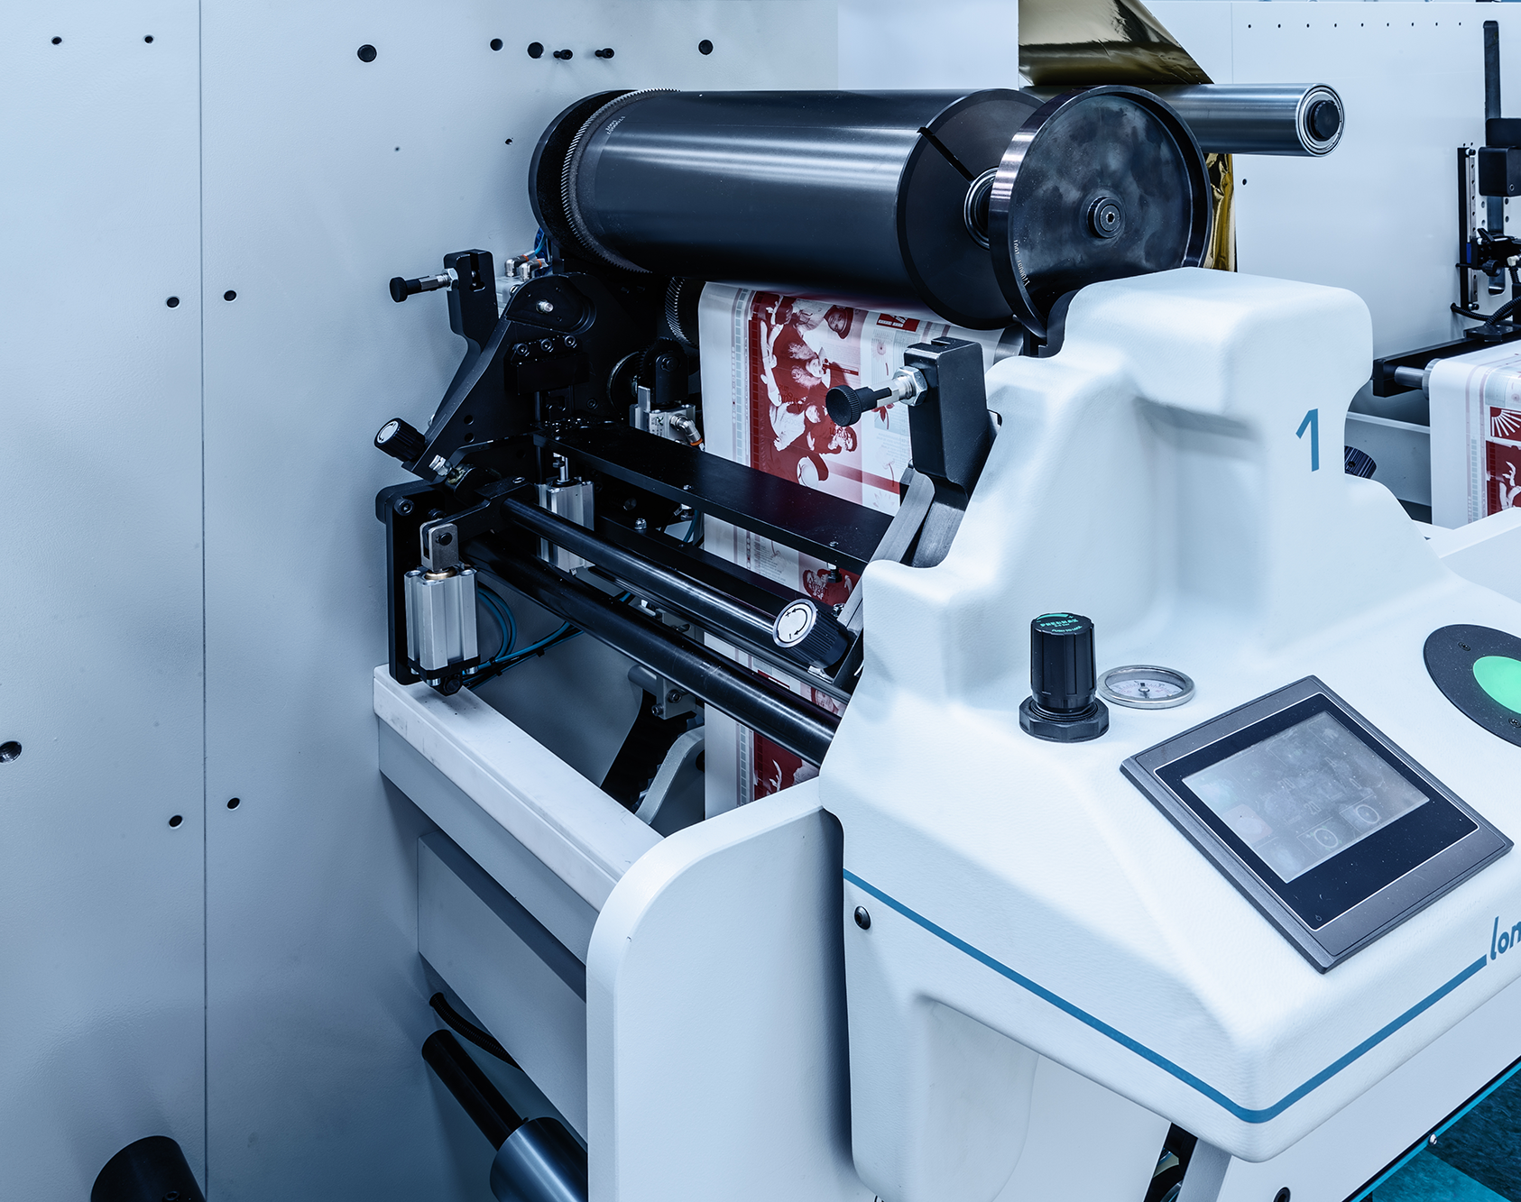
MODULAR SOLUTIONS
SEMI
ROTARY
FLEXO
DIECUT
A unit that allows the die cutting of any label shape.
31
31
31

Slide 32
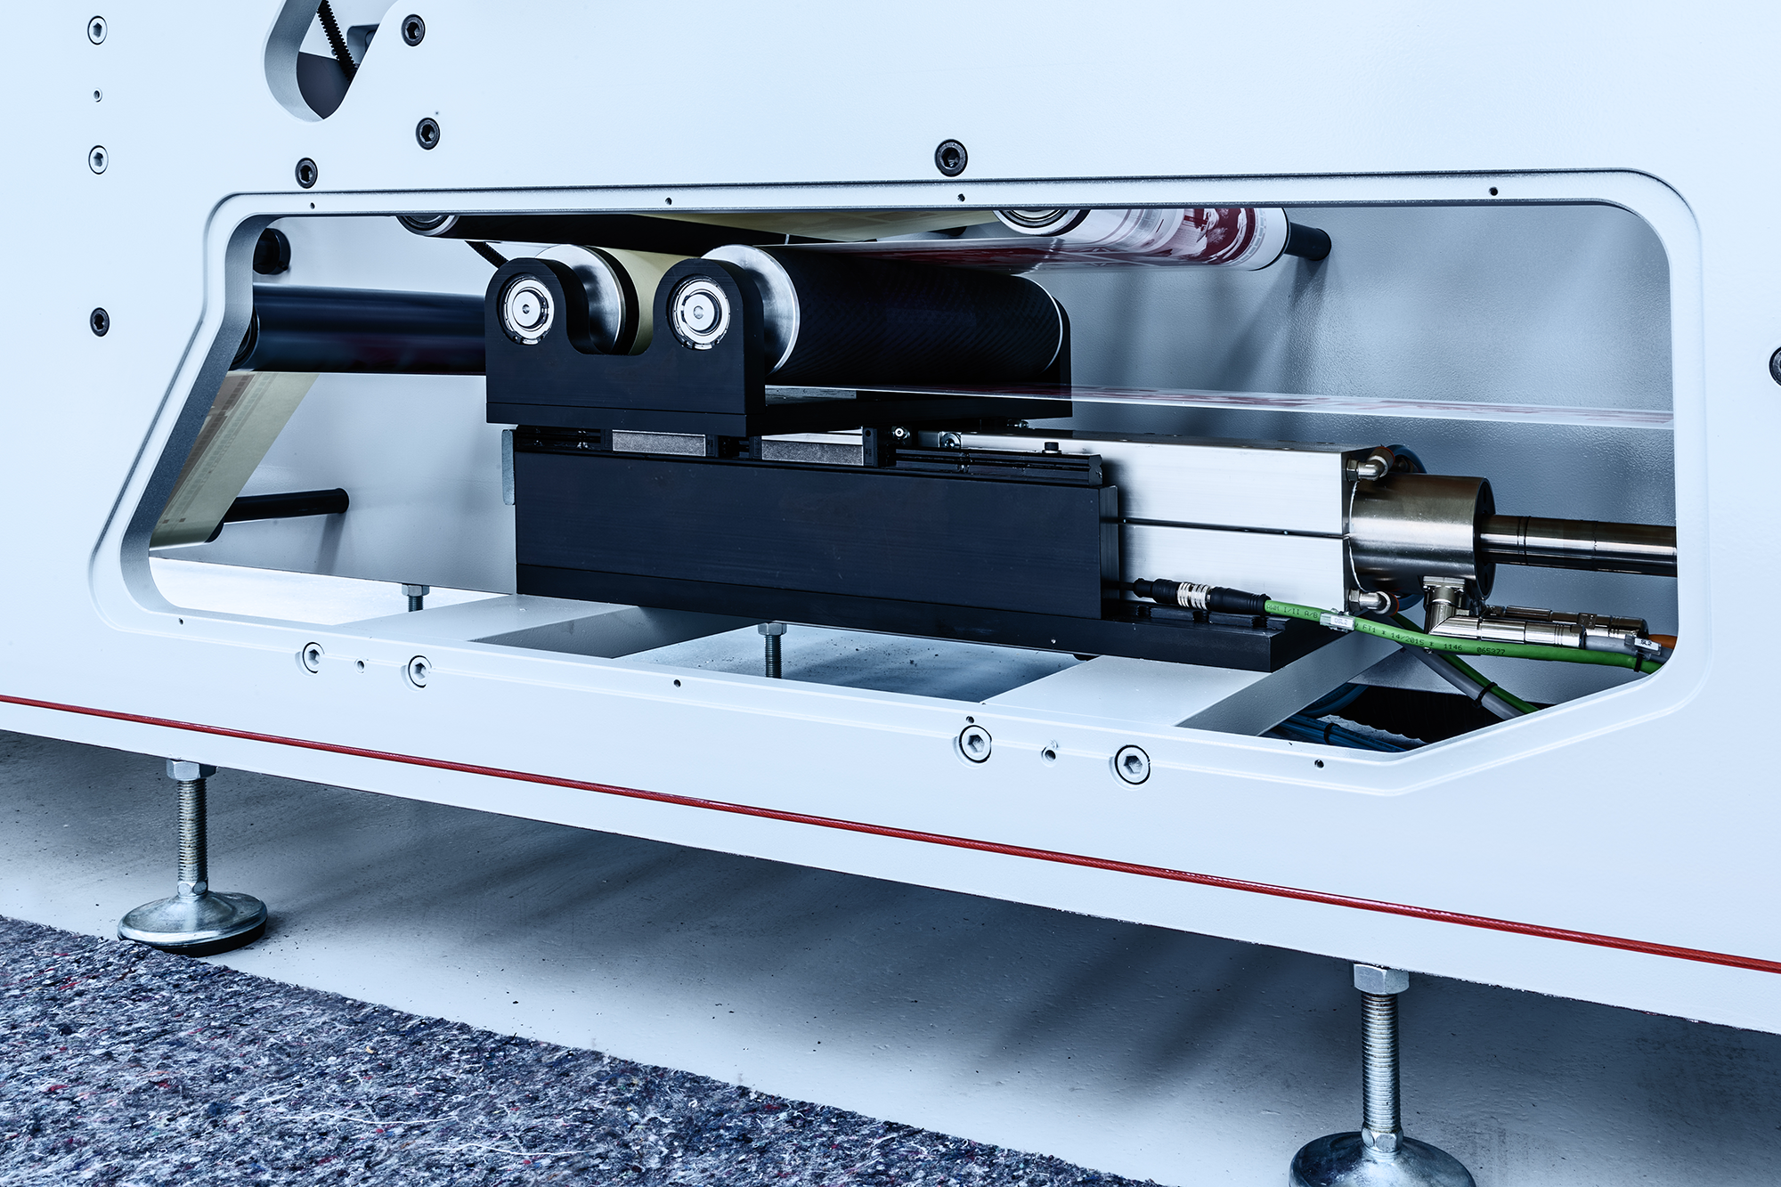
MODULAR SOLUTIONS
SEMI
ROTARY
DIECUTTING
Die cutting unit equipped with innovative paper recovery system through a linear cartridge that allows the use of a single magnetic cylinder for all printing formats for easy and quick job changeover.
32
32
32

Slide 33

MADE IN ITALY SINCE 1988
APPLICATION
FIELD
33

Slide 34
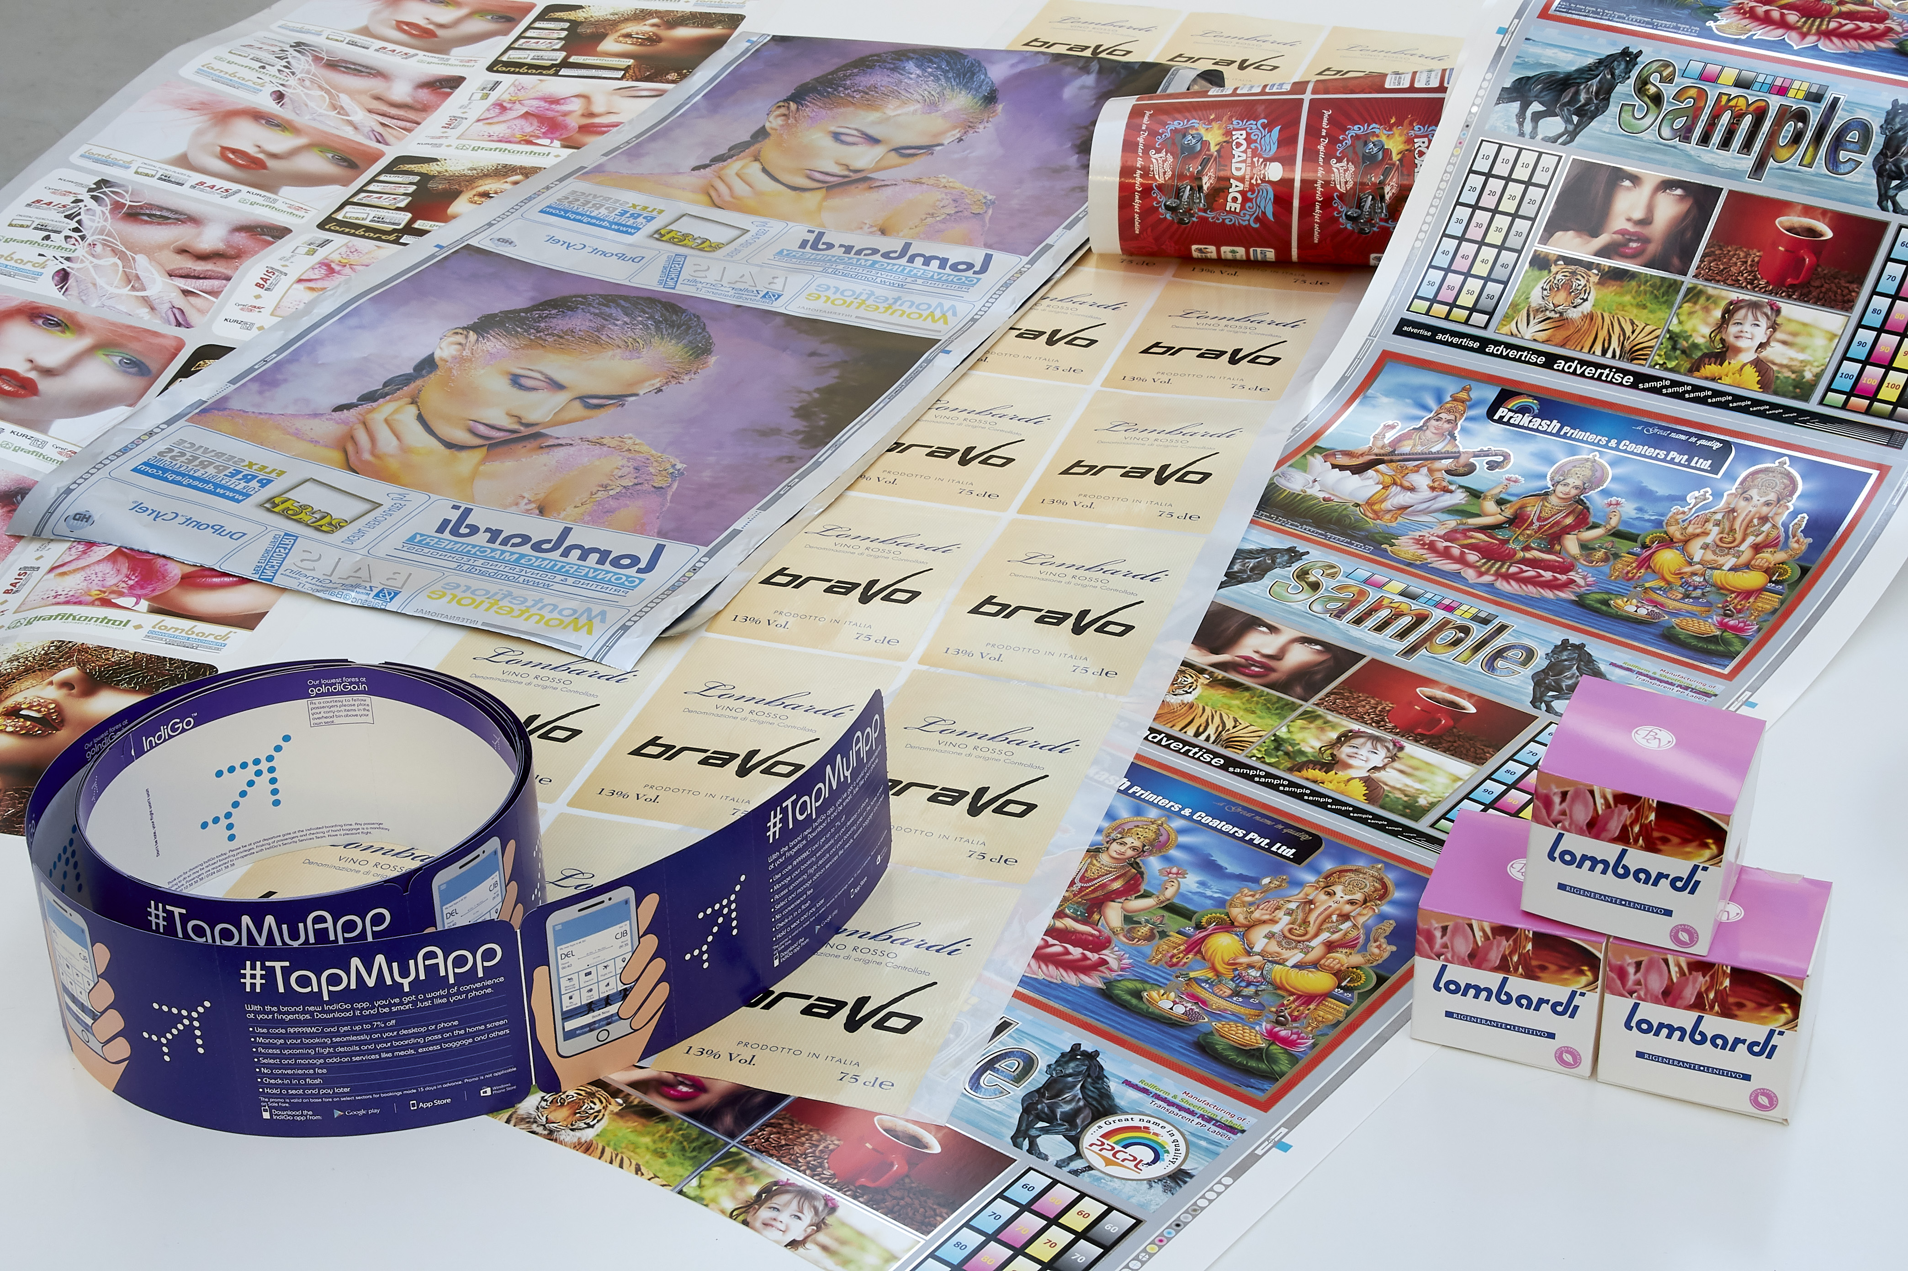
MADE IN ITALY SINCE 1988
34

Slide 35
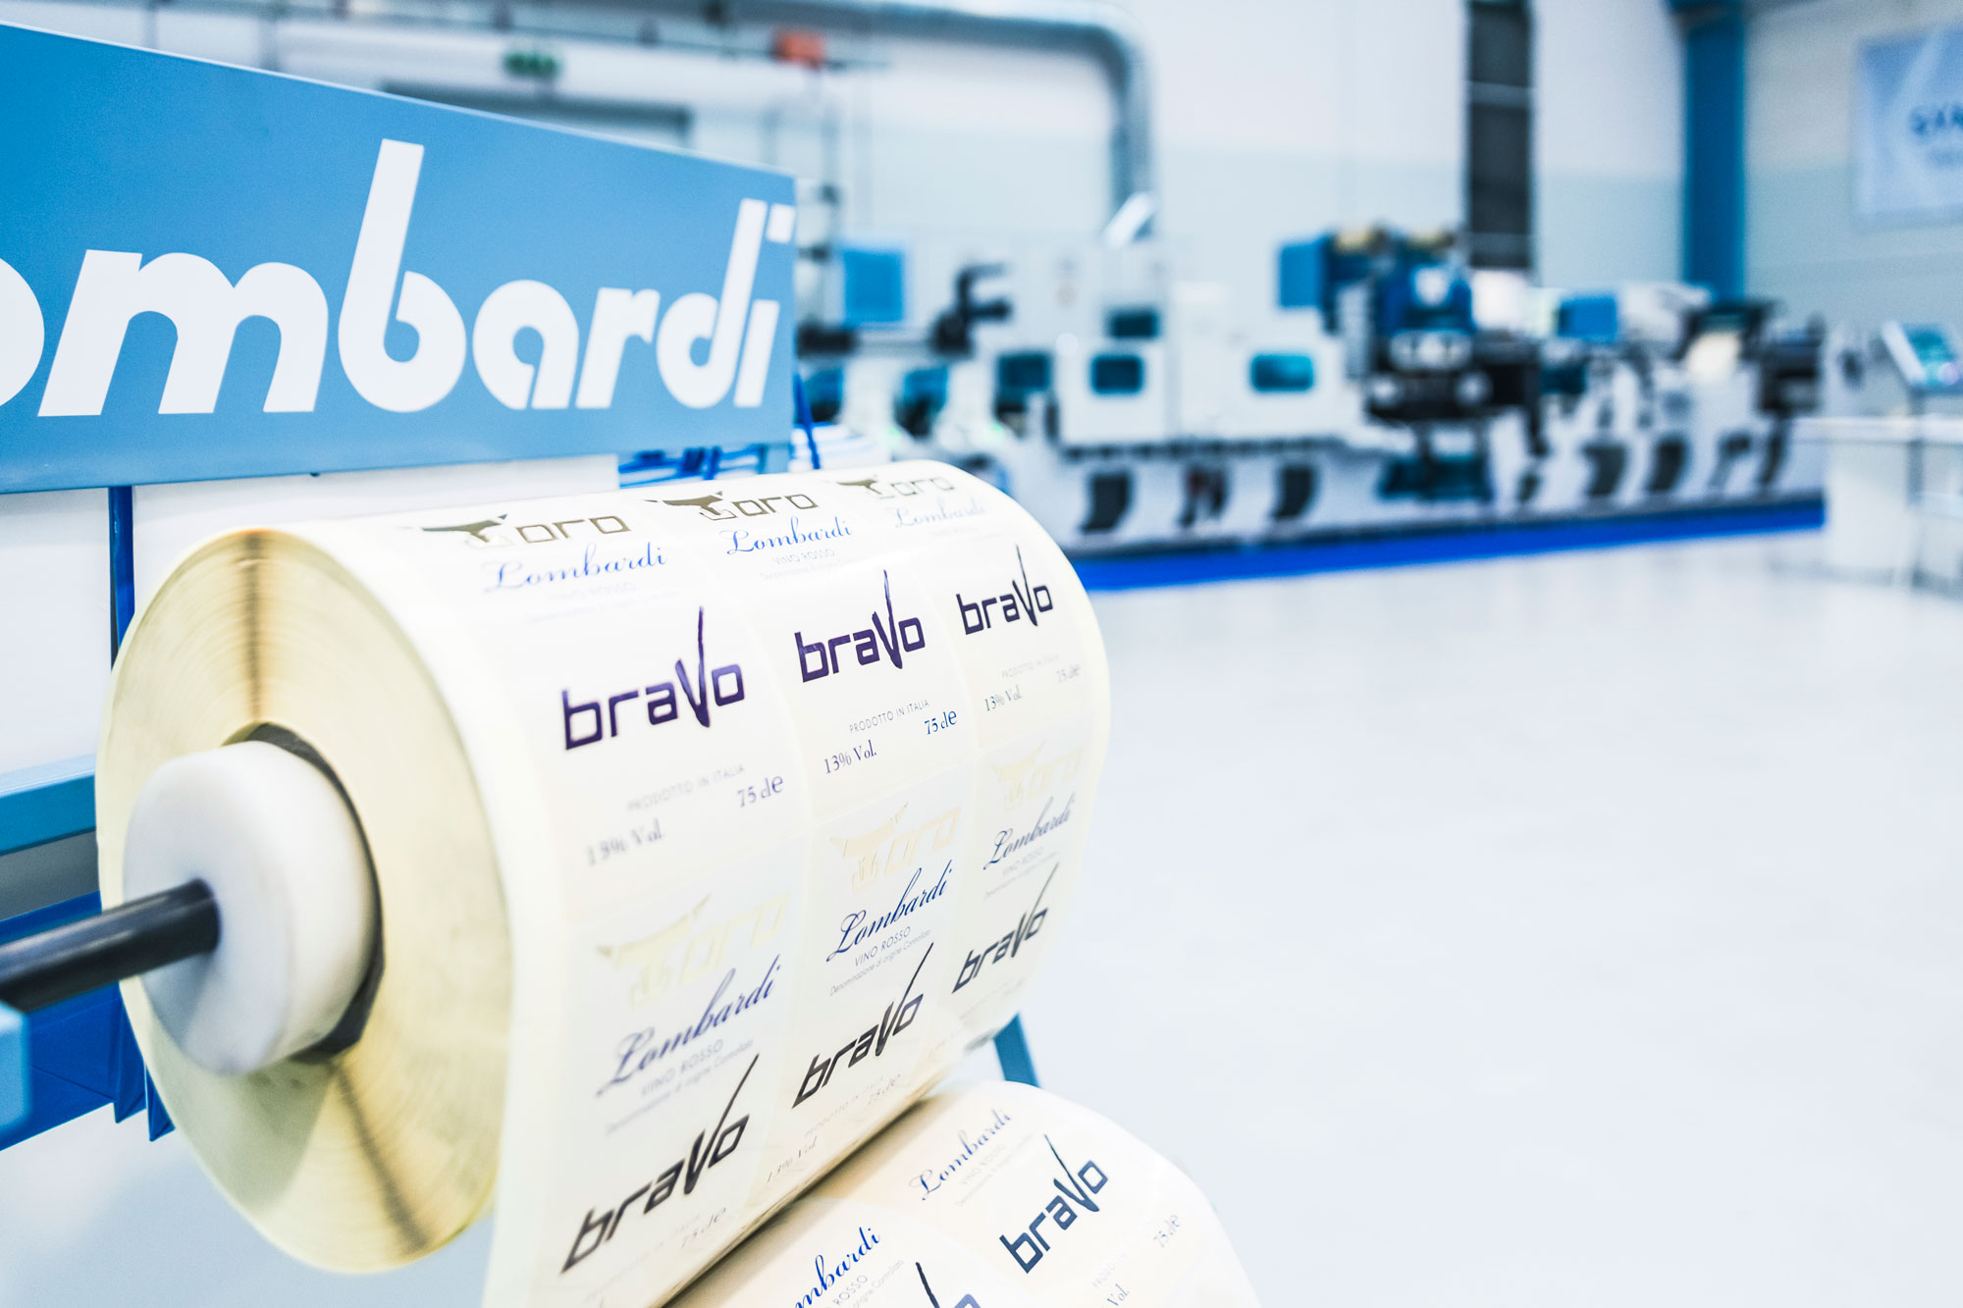
MADE IN ITALY SINCE 1988
35

Slide 36
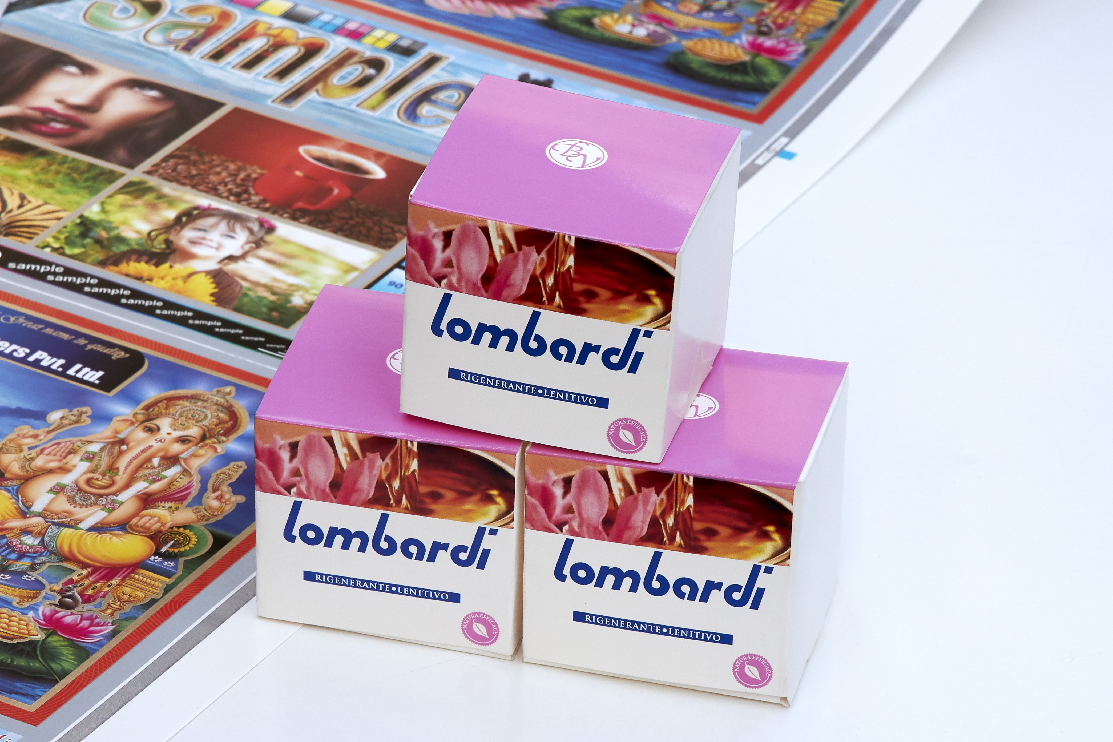
MADE IN ITALY SINCE 1988
36

Slide 37


MADE IN ITALY SINCE 1988
APPLICATION FIELD
FLEXOLINE
SYNCHROLINE
INVICTA
ADHESIVE LABEL
PAPER
IML
ALUMINIUM
CARTON
ADHESIVE LABEL
PAPER
IML
ALUMINIUM
CARTON
ADHESIVE LABEL
PAPER
IML
ALUMINIUM
CARTON
SHRINK SLEEVES
FLEXIBLE PACKAGING
BOOKLETS
WRAP AROUND
SHRINK SLEEVES
FLEXIBLE PACKAGING
BOOKLETS
WRAP AROUND
SLEEVE TECHNOLOGY
37

Slide 38

MADE IN ITALY SINCE 1988
CONFIGURATIONS
38

Slide 39
FLEXOLINE
Flexo Entry Level.

Slide 40
FLEXOLINE
Easy job changeover

Slide 41
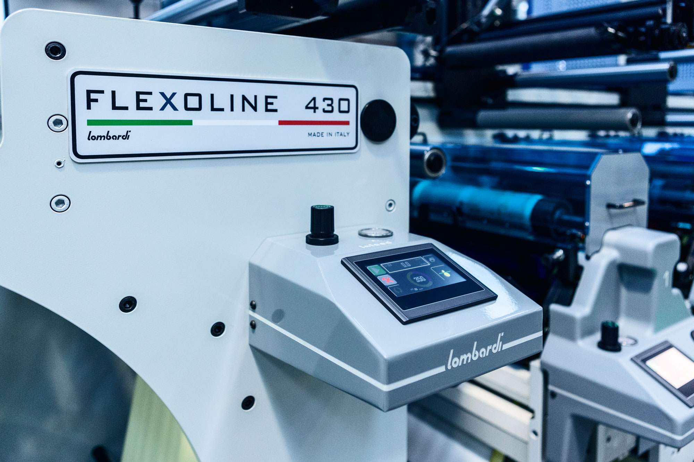
MADE IN ITALY SINCE 1988
FLEXOLINE
Able to guarantee the highest quality printing as well as quick and easy job changeover. Flexoline offers advanced technology solutions delivering excellent printing register at high speeds.

Slide 42
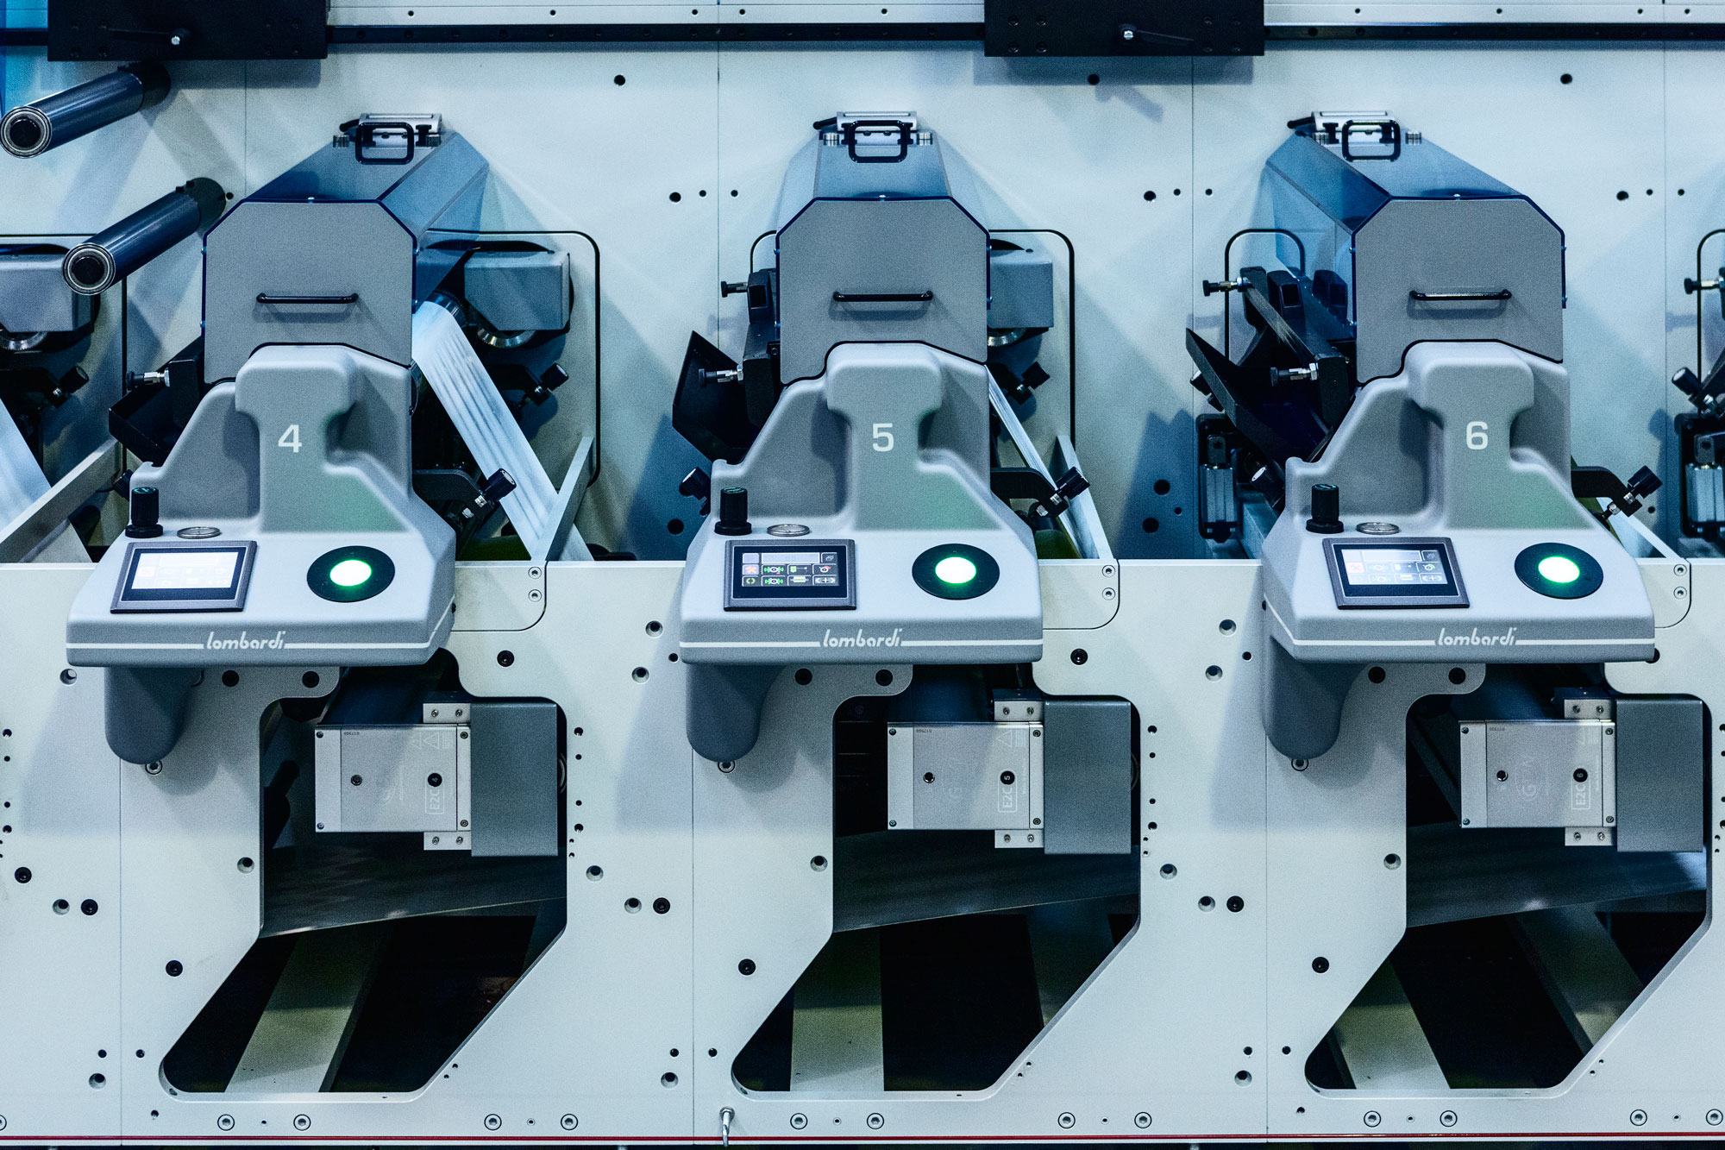
MADE IN ITALY SINCE 1988
FLEXOLINE

Slide 43
FLEXOLINE

Slide 44
SYNCHROLINE
Full servo automatic flexo press.

Slide 45
SYNCHROLINE
The cutting-edge technology of Lombardi’s range.
Full servo, with automatic pre-register and register.

Slide 46
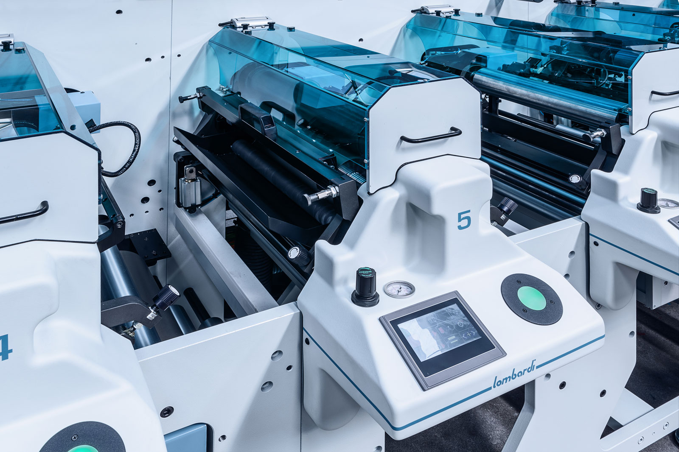
MADE IN ITALY SINCE 1988
SYNCHROLINE
Designed to deliver the Best Performance for label and packaging printing. The name ‘Universal Machine’ has been gained because there are no limitations of printable materials: BOPP, PVC, PE, PET, paper, adhesive paper, thermal paper, paired materials, cardboard.

Slide 47
SYNCHROLINE

Slide 48
INVICTA
Mid web flexo packaging press.

Slide 49
INVICTA
Automatic pre-register
and register.

Slide 50
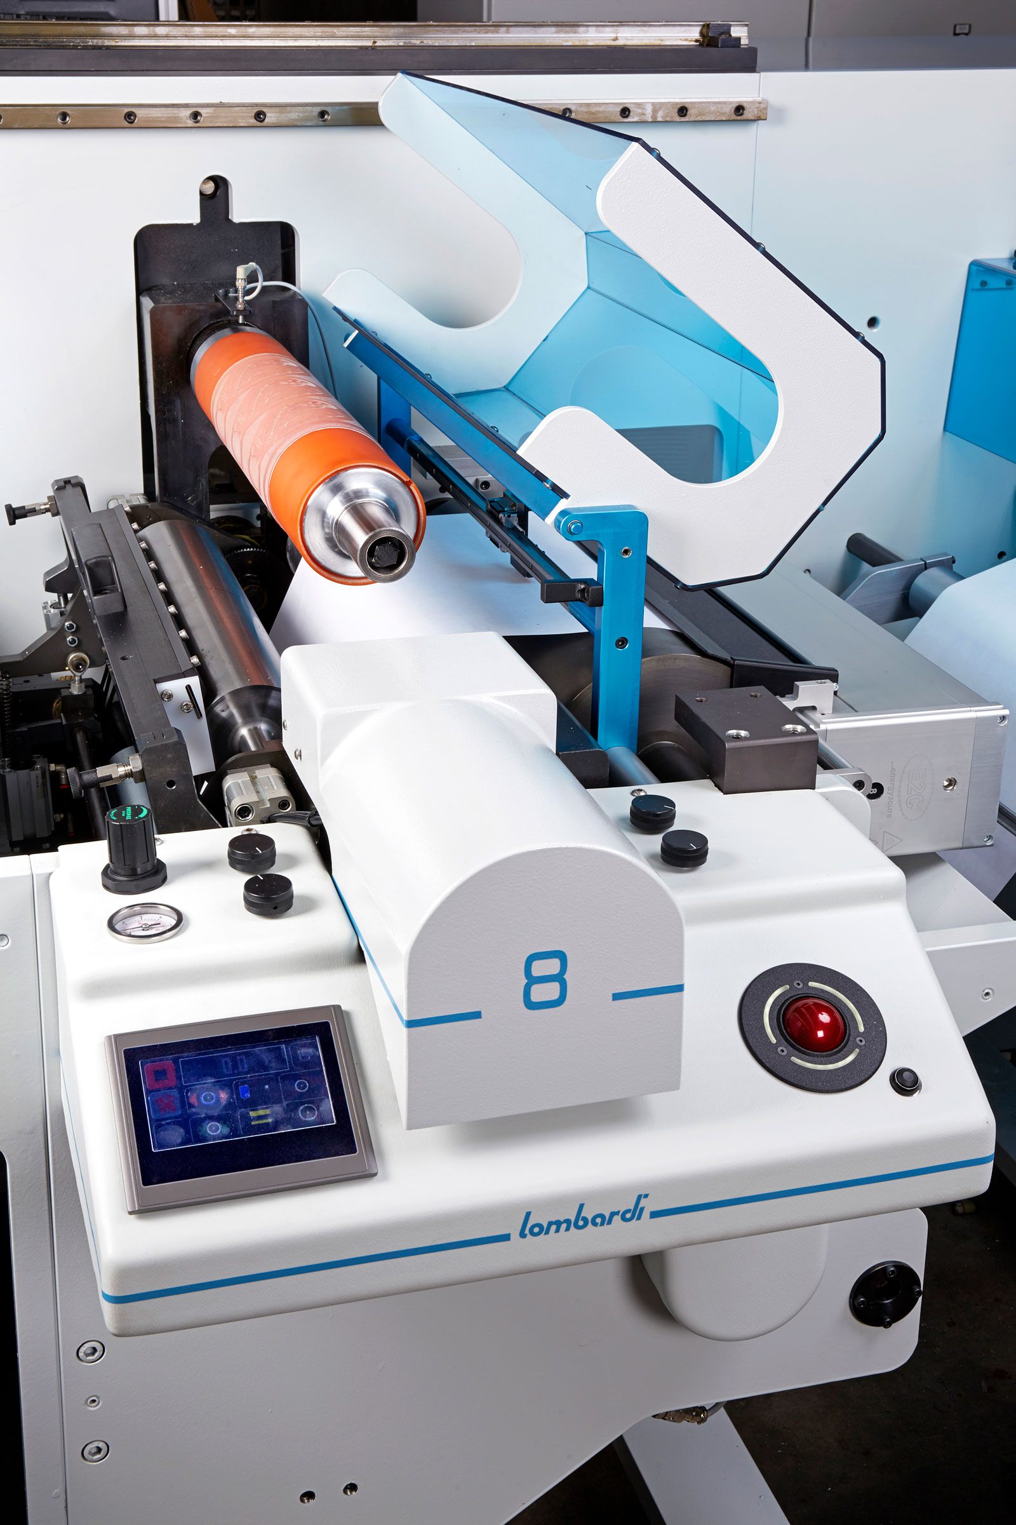
MADE IN ITALY SINCE 1988
INVICTA
Capable of printing on every substrate: BOPP, PVC, PE, PET, paper, adhesive paper, thermal paper, cardboard, paired materials. Invicta is a flexible, dynamic and user-friendly printing machine that minimizes the operator’s efforts.

Slide 51
INVICTA

Slide 52
MADE IN ITALY SINCE 1988
CONFIGURATIONS
PRE-REGISTER
REGISTER
TENSION CONTROL
SHRINK SLEEVES
SECOND
PASS
FORMAT
VARIATION
FLEXOLINE
FLEXOLINE+
FLEXOLINE++
SYNCHROLINE
INVICTA
52

Slide 53
www.lombardi-na

